Slide 1

PROJ(CS)803
CSHB Model
Crypto-Steganographic Hybrid Blockchain Model for Network Security
Presented By:
1. Akash Kumar Sen
2. Arijit Mukherjee
3. Sandeep Shaw
4. Surajit Bera
(GCECTB-R19-3002)
(GCECTB-R19-3007)
(GCECTB-R19-3022)
(GCECTB-R19-3036)
Supervised By:
Dr. Bijoy Kumar Mandal
Assistant Professor, Department of CSE, GCECT

Slide 2

#1 Project Overview
Abstract
Introduction
Literature Survey
Proposed Method

Slide 3



Abstract
The purpose of this project work is focused on developing a secure and efficient model for data transfer between client and server that is end-to-end encrypted and promotes data integrity. It is demonstrated using a simple text messaging application which provides assurance to the user by securing their data.
End-to-End Encrypted
Data Integrity
Strong Hashing & Encryption

Slide 4



Man in the Middle Attack
Data Breaching

Slide 5

Introduction
As majority of our activities are digitalized and performed online. Our personal and confidential information is transmitted through the internet, making network security crucial to protect against third-party attacks.
We will illustrate CSHB model using a text messaging application, incorporating secure hashing, advanced cryptography, steganography, and blockchain concepts with existing NoSQL databases.
Our model ensures the security of the message data by providing protection against MITM attacks, data spilling, brute force, and side-channel attacks. With our proposed model, we aim to prioritize the safety of confidential information across the network.

Slide 6

Literature Survey
AES is considered unbreakable, but issues exist in AES-128 and AES-256. AES-256 has a weak key schedule, while boomerang and rectangle attacks combine side-channel attacks to exploit nonlinear transformations, breaking reduced-round versions of AES.
Stego-object data can be easily accessed by attackers via image steganography algorithm. Hence, data encryption, dynamic image selection with error detection should be used to prevent manipulation.
Hybrid blockchain can maintain data integrity without compromising speed by using traditional database approaches. However, as the data size increases, the time complexity to verify transactions also increases, which is a disadvantage of using blockchain technology.

Slide 7
Proposed Method
The principle idea is to construct a model where at various phases of data transmission from client to server and vice-versa, a specific algorithm is utilized to secure the data. This algorithm includes hashing, dynamic crypto-steganography, and the use of hybrid blockchain database storage.
Thus this model of various algorithms is used to implement a text messaging app system that provides a secure data transfer from the client to the server and stores that particular data inside the database such that the integrity of data is preserved.
Constant Key Storing
Hashing & Dynamic Encryption
Image Steganography
Storing Data to Server
Fetching Data from Server

Slide 8
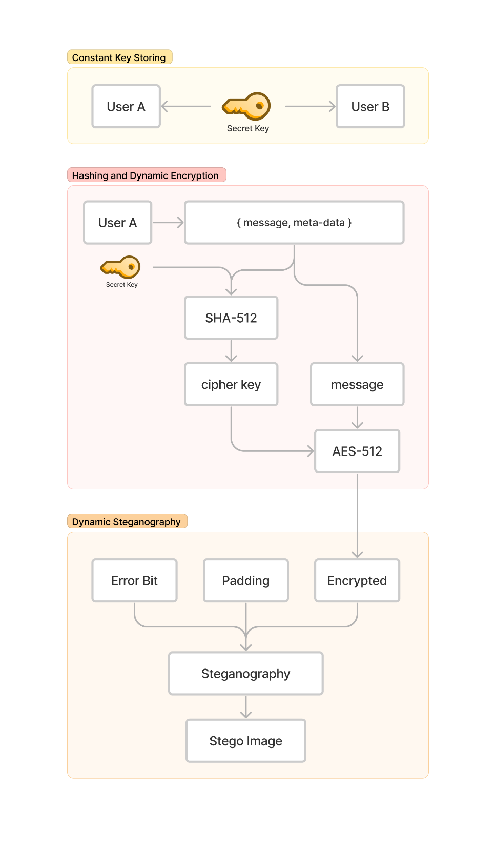
Constant Key Storing
Different Server
Same Database
First of all the users of the chatroom will share a common and consistent secret code generated randomly when the chatroom is established.
Depending on the nature of security these secret code may be stored either in user's device in decentralized manner or inside more secure layered database in centralized manner.
External Hardware Security
Cloud Storage

Slide 9
Constant Key Storing
Hashing & Dynamic Encryption
The secret key combined with other fields of the message will be used to generate a hash value using Secure Hash Algorithm (SHA-512)
Then this hash value generated above is used as a symmetric key for the Advance Encryption Standard algorithm (AES) to encrypt the message.

Slide 10
Image Steganography
Constant Key Storing
According to the length of the encrypted message, a particular image of given dimensions will be calculated and used for the effective embedding of data inside the image. Then the Stego-object is sent to the server via API.

Slide 11
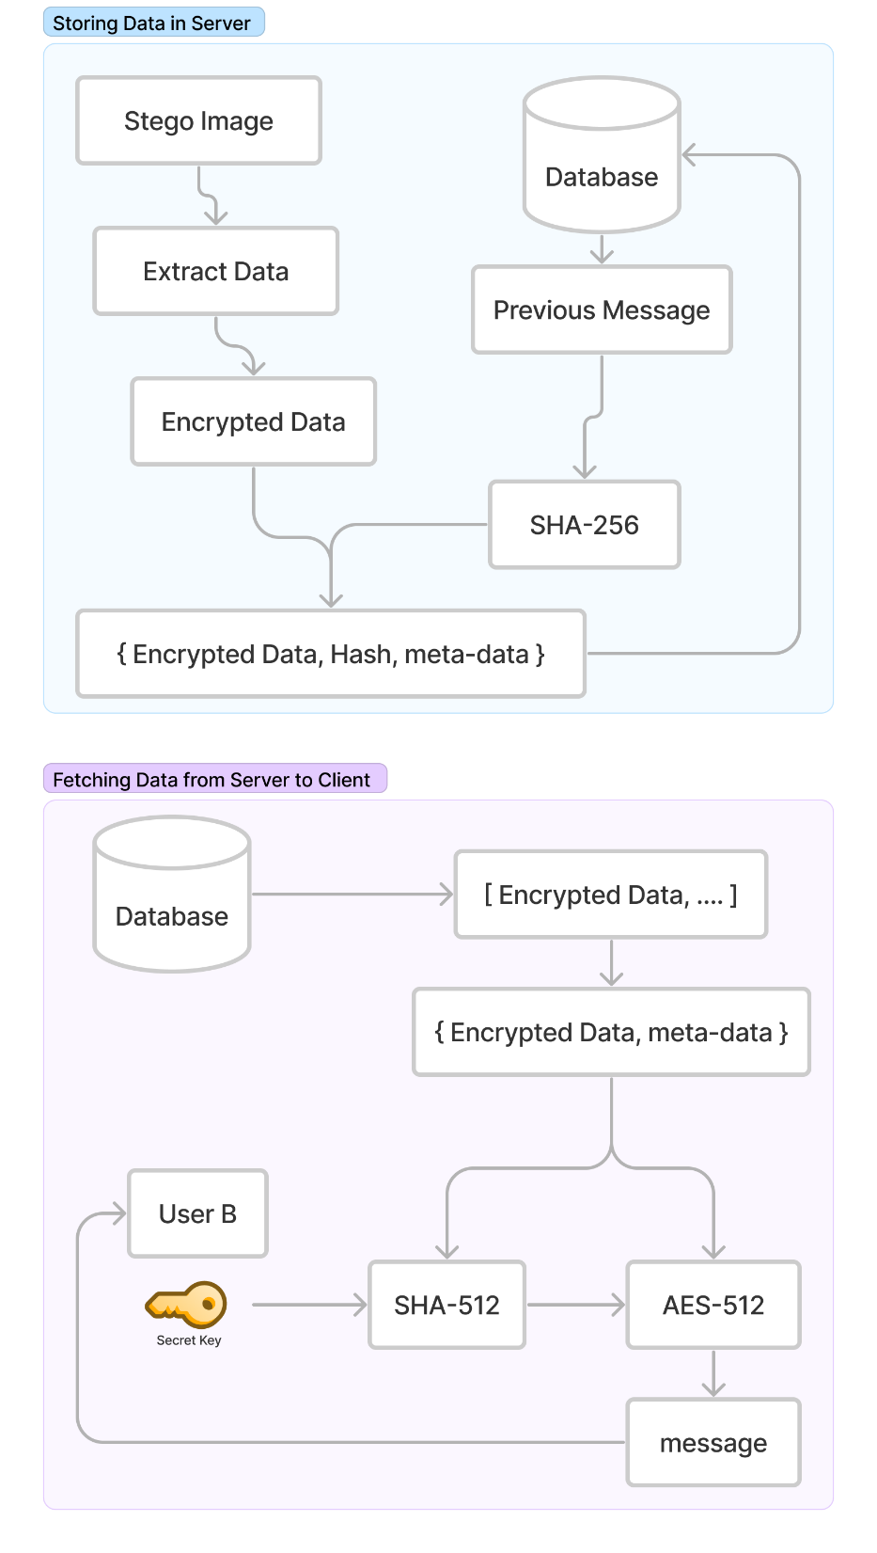
Constant Key Storing
Storing Data to Server
At the server, the message is extracted from Stego-object which outputs the encrypted message.
This data is fetched and stored inside the database. While storing the encrypted message in a database, the traditional database is perform and additional partial blockchain function by linking the hash of the previous messsage in the same chat room with the current message id using any Secure Hashing Algorithm.

Slide 12
Constant Key Storing
Fetching Data from Server
The chat data can be retrieved in bulk from the server to the client. As the data was stored in encrypted format therefore it is still secure and at the client side the chat will be decrypted.
The symmetric key can be obtained using the constant secret key and other attributes of the message which is passed to the AES and the plain text is obtained from the cipher text and is rendered on the screen.

Slide 13

Algorithm
Secure Hash Algorithm
Base64 Encoding
AES-512 with 512 bits state
Secure Data with ERROR Bits
Image Steganography
Hybrid Blockchain

Slide 14
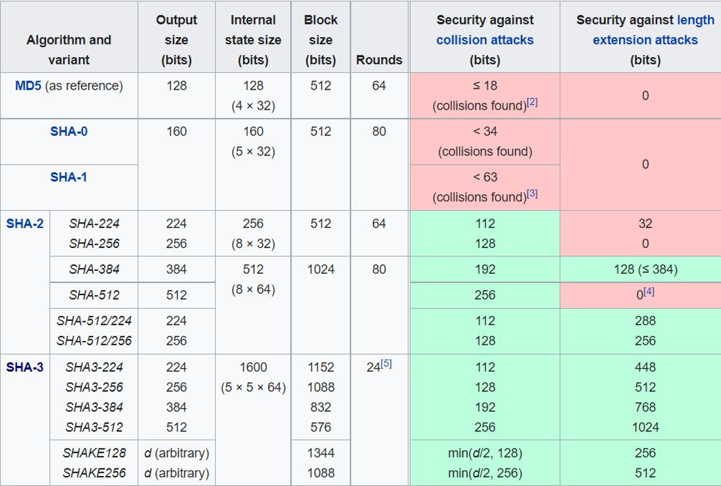
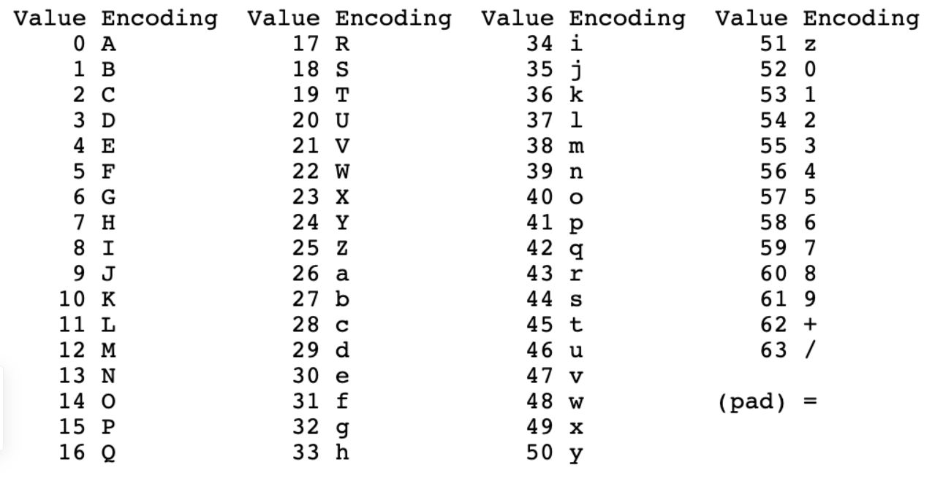
SHA3-512
Base64 Encoding
{{{
Image Source:
https://en.wikipedia.org/wiki/Secure_Hash_Algorithms
https://www.siakabaro.com/base64-decode/

Slide 15
Image Steganography
Hybrid Blockchain
SHA3-512
The implementation of this algorithm is static in nature. As the data which is converted to stego-object may vary which can either cause redundancy of padded bit or may not fully fit inside the stego-object. Moreover it should also support the mechanism to detect errors using error bits.
Overall the image steganography algorithm in our case should be dynamic in nature to accommodate the data perfectly without much redundancy and also to support error detection.
Despite the strength of blockchain, scalability issues like low throughput, high latency, storage issues and poor read performance are its big challenges. Moreover, Blockchain applications have much lower throughput compared to non-blockchain applications.
For example,
Bitcoin support 3–4 transactions per second as compared to UPI which supports 10,000 transactions per second.
Moreover to overcome this challenge the linked hash concept can be implemented in traditional SQL and No-SQL databases with sufficient caching

Slide 16
AES-512 with 512 bits state
Key Scheduling
Encryption & Decryption
Process of key expansion where a short key is expanded into a number of separate round keys that are used at different rounds in the encryption-decryption process.
It uses the round keys generated in the Key Scheduling to obtain a cipher text at each round and vice-versa.
The rounds consist of an initial round, an intermediate round, and the final round and it varies depending on the variants of AES consisting of 128 bit state.
AES | Key Size | Round Keys | Total Keys
128 | 128b / 16B | 10 | 11
192 | 192b / 24B | 12 | 13
256 | 256b / 32B | 14 | 15
Rot Word
Sub Word
Byte Substitution
Shift Column
Round Constant
Add Round Keys
Mix Column

Slide 17
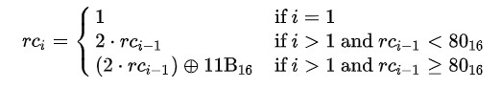
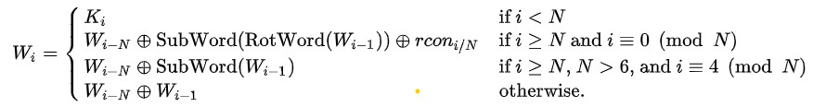
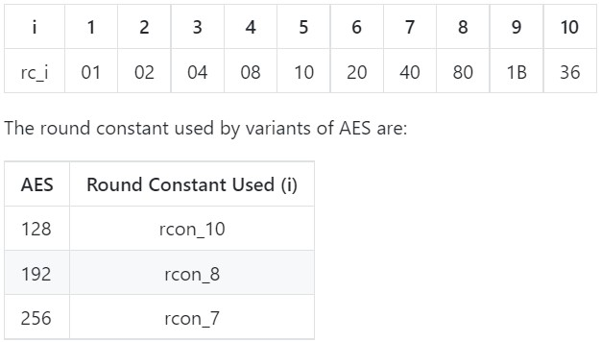
Key Scheduling
Rot Word
One byte left-circular shift
Sub Word
The substitution of the four bytes of the word using AES S-Box.
Round Constant
Image Source:
https://en.wikipedia.org/wiki/AES_key_schedule

Slide 18
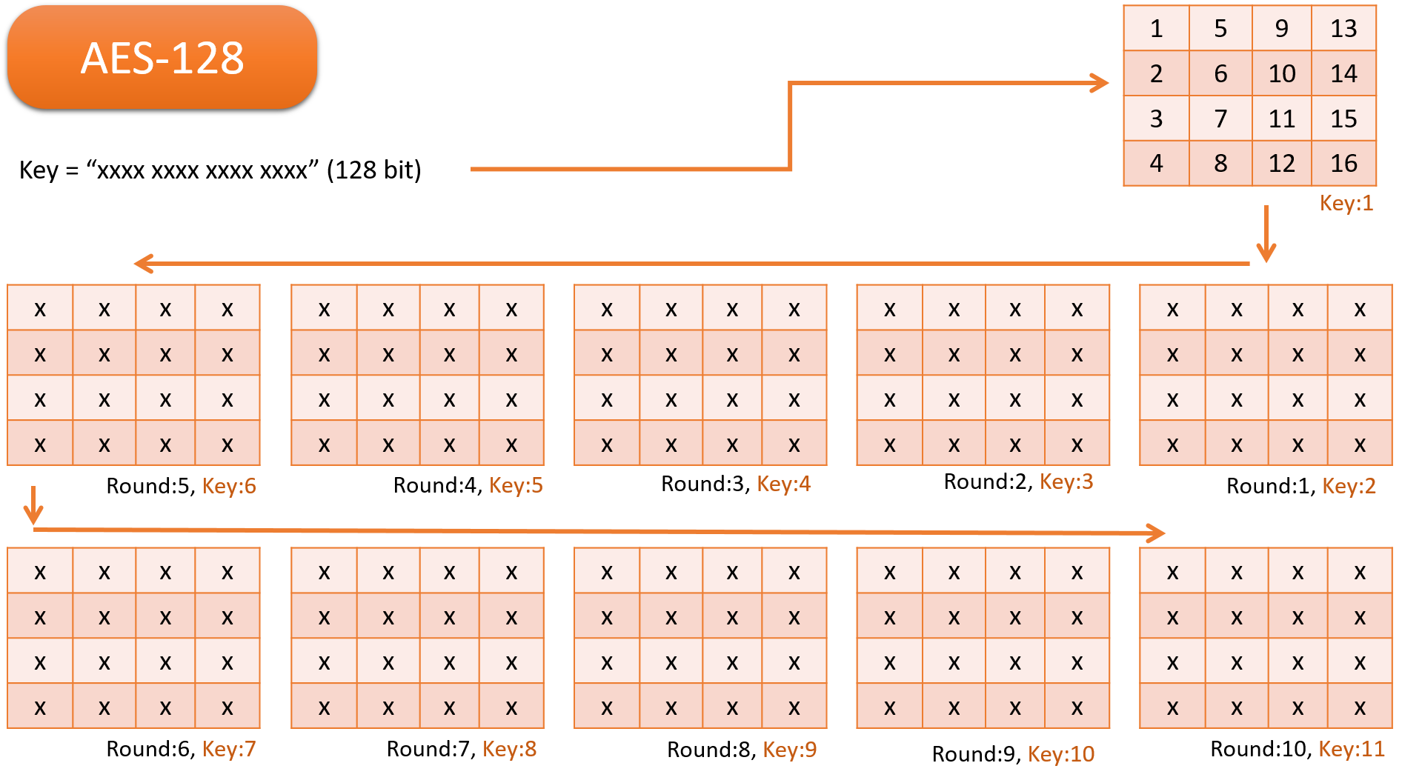
Image Source:
https://github.com/sandeep-shaw10/cshb-model

Slide 19
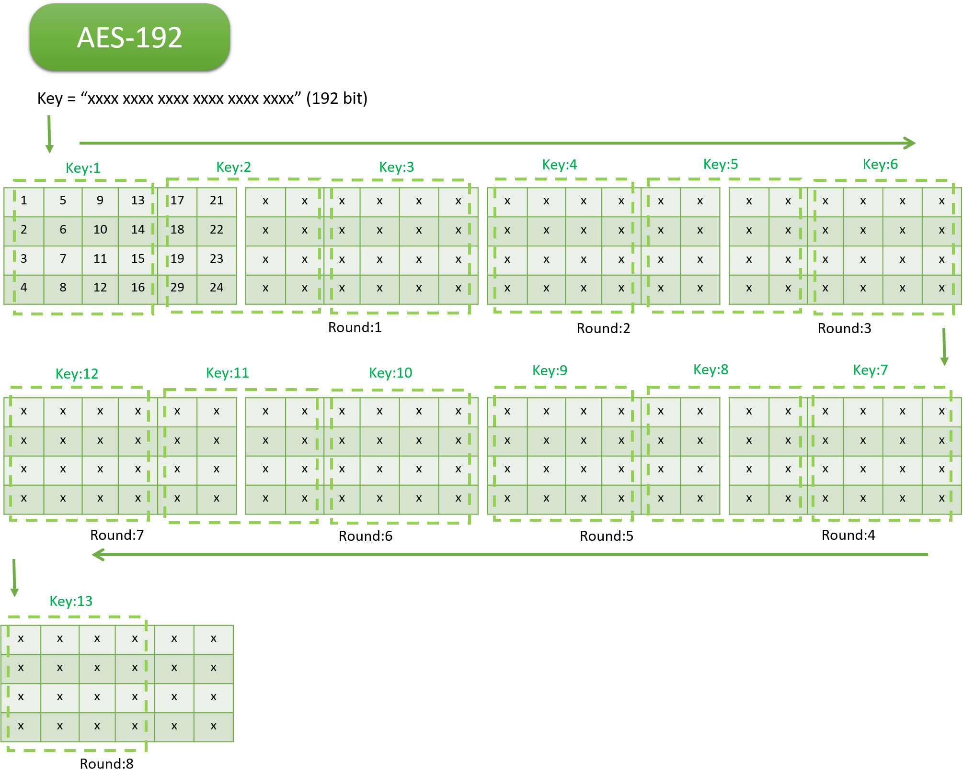
Image Source:
https://github.com/sandeep-shaw10/cshb-model

Slide 20
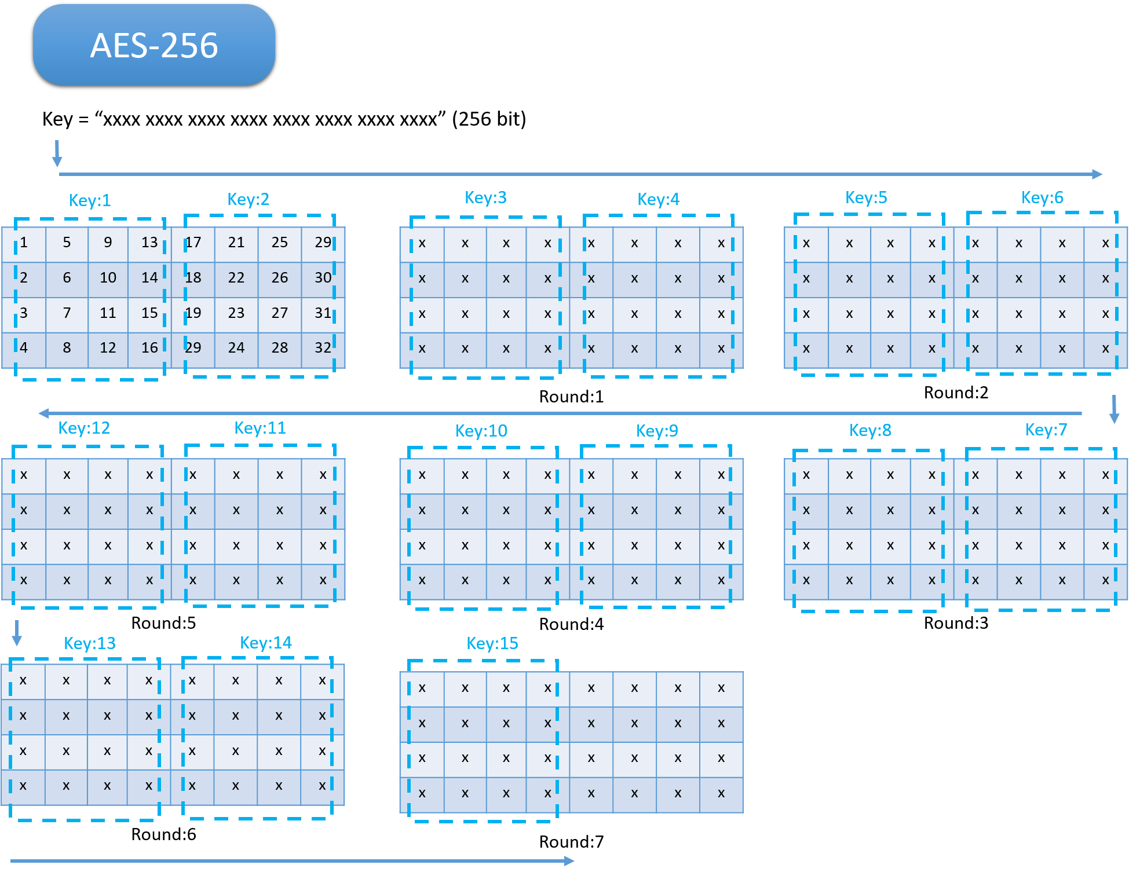
Image Source:
https://github.com/sandeep-shaw10/cshb-model

Slide 21
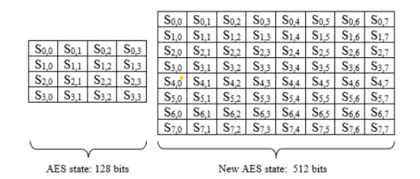
Encryption & Decryption
State Array
512 bits
128 bits
AES-128, 192, 256
AES-512
Image Source:
https://en.wikipedia.org/wiki/Advanced_Encryption_Standard

Slide 22
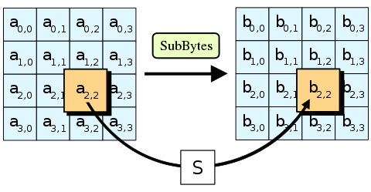
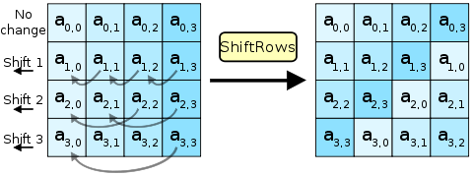
Byte Substitution
Shift Rows
Image Source:
https://en.wikipedia.org/wiki/Advanced_Encryption_Standard

Slide 23
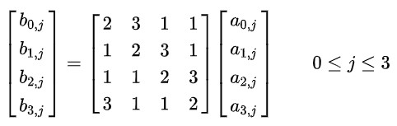
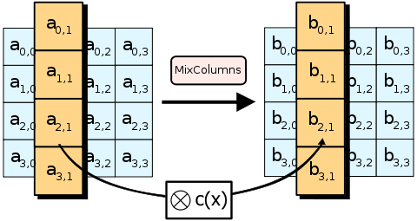
Mix Column
14 11 13 9
9 14 11 13
13 9 14 11
11 13 9 14
Image Source:
https://en.wikipedia.org/wiki/Advanced_Encryption_Standard

Slide 24
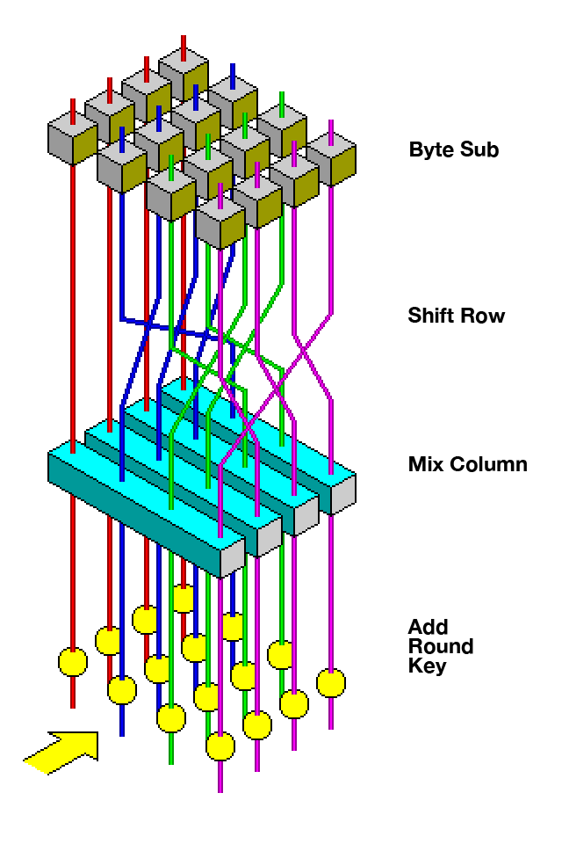
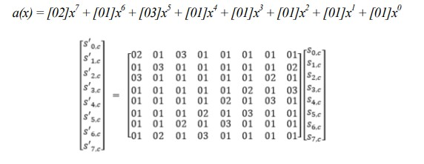
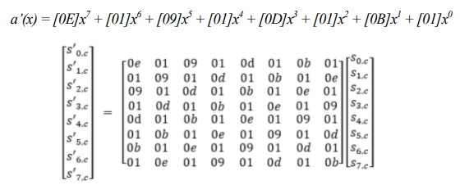
Mix Column for 512 state array
Image Source:
https://en.wikipedia.org/wiki/Advanced_Encryption_Standard

Slide 25
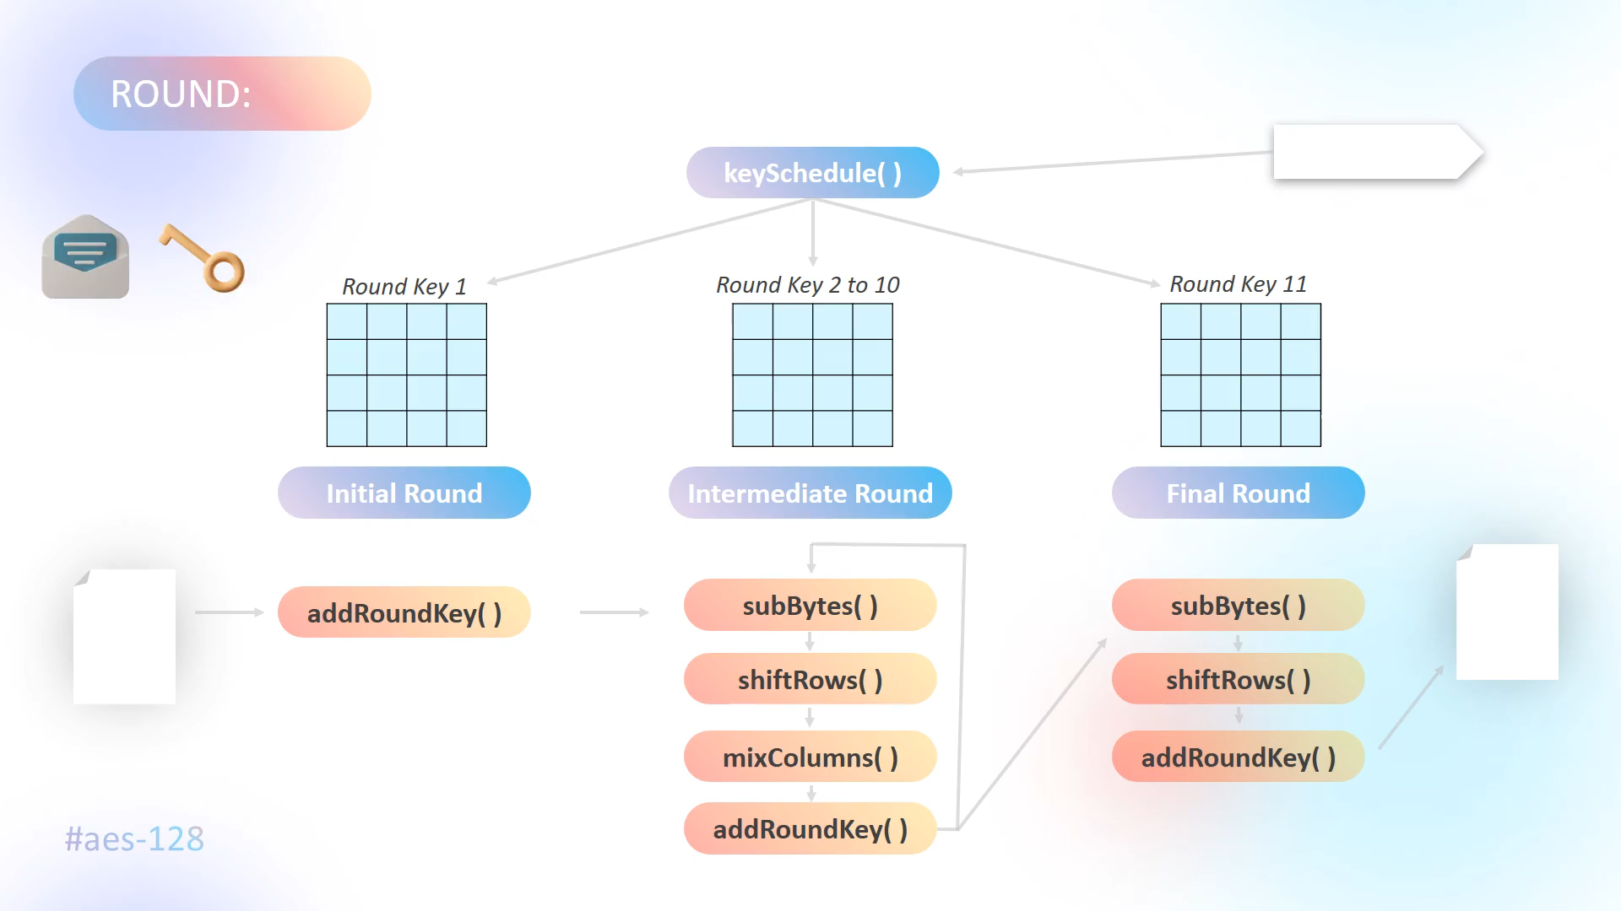
Image Source:
https://github.com/sandeep-shaw10/cshb-model

Slide 26
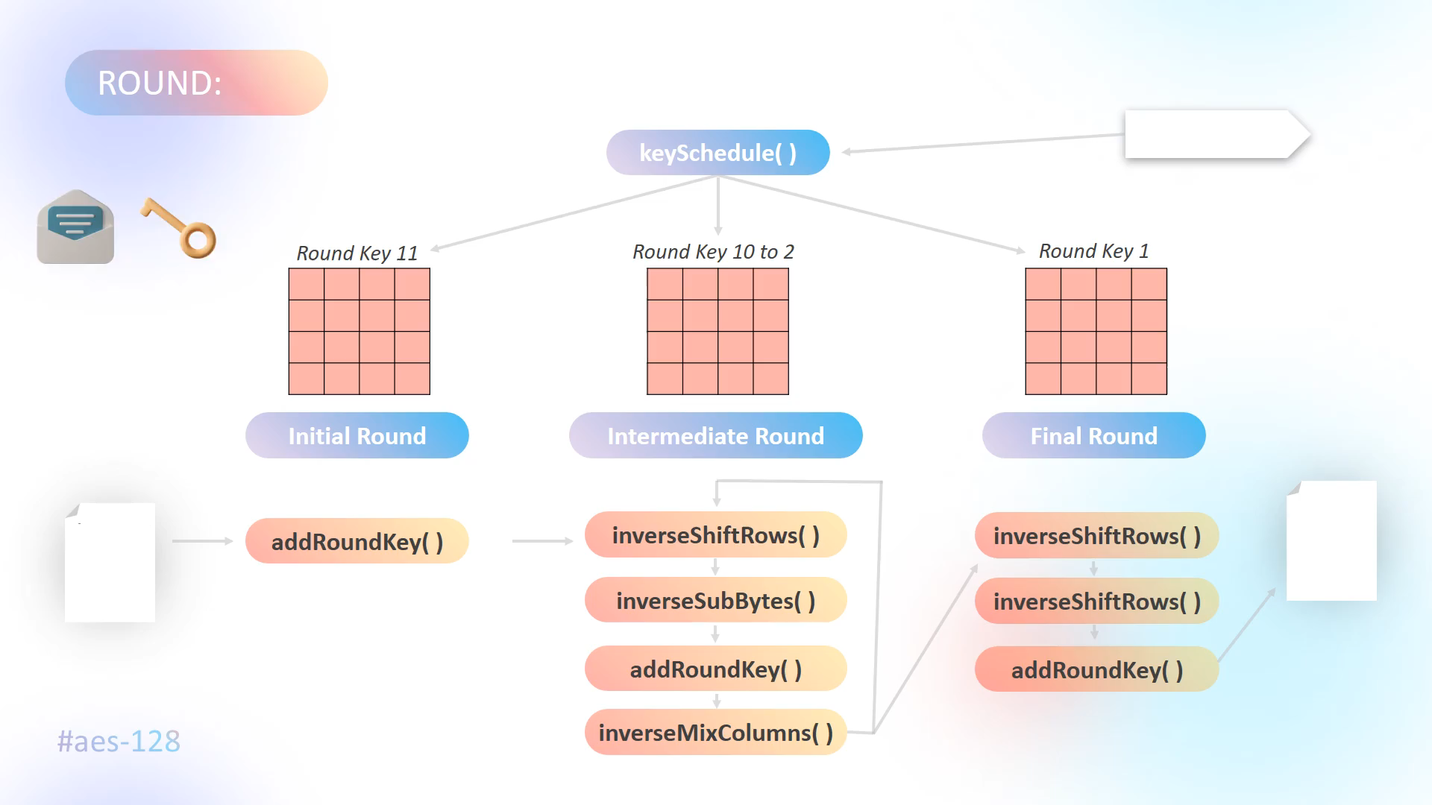
Image Source:
https://github.com/sandeep-shaw10/cshb-model

Slide 27

Analysis
Key Scheduling Time & Throughput
Variation in Key Scheduling
Encrypt & Decrypt Time

Slide 28
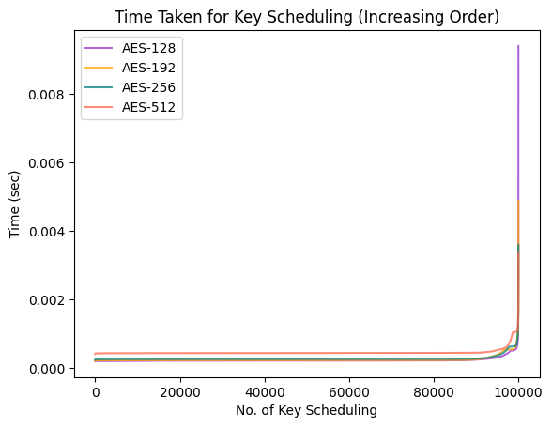
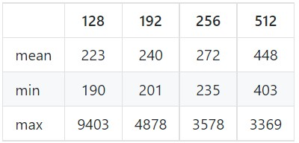
Key Scheduling Time
The observation of the Key Scheduling time for AES algorithm on 1,00,000 keys (1 lakh).

Slide 29
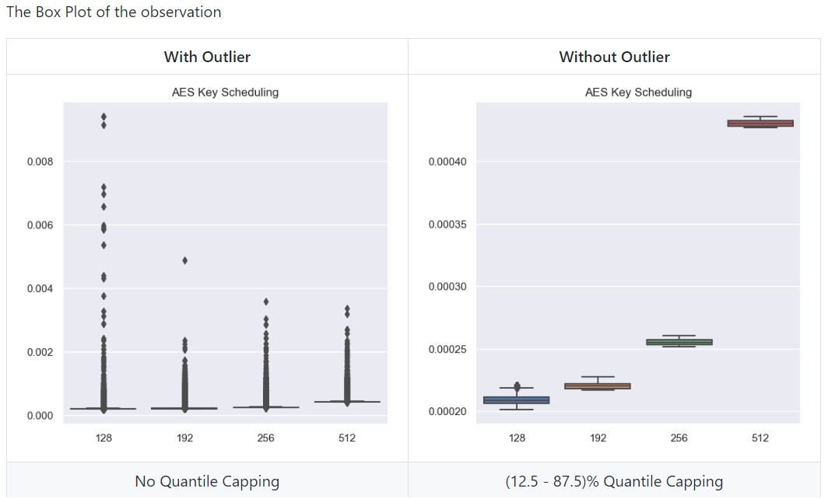

Slide 30
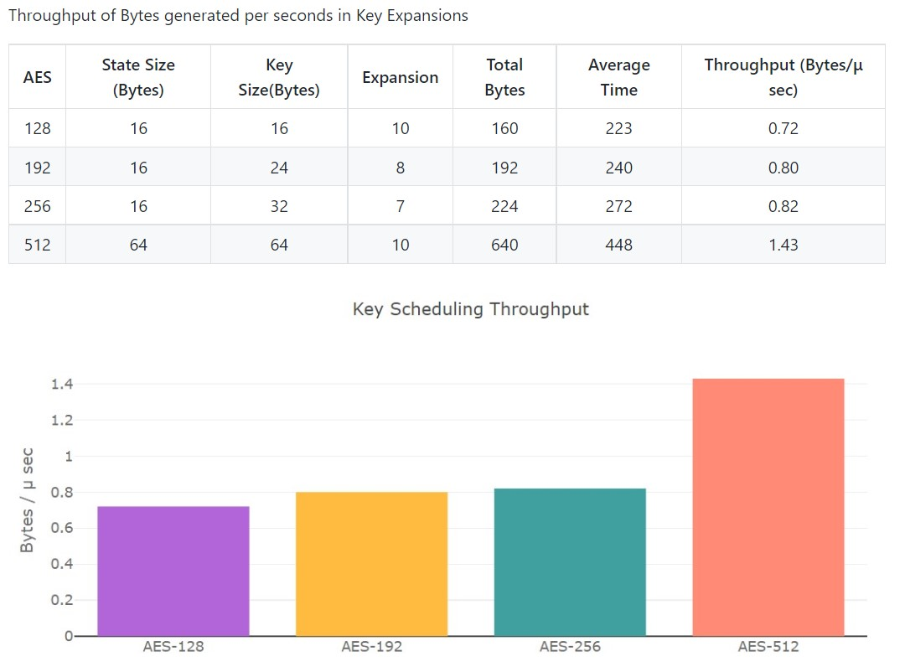

Slide 31
Observation
We can observe that the proposed AES-512 algorithm takes twice the time than AES-128
There exist certain key combination for which AES-512 is even faster than traditional AES.
However, the traditional AES key scheduling works on 128 bit state but AES-512 works on 512 bit state. Therefore we can observe that the Throughput for AES-512 higher than other AES variants.
In the worst case, AES-512 can be delayed up to 3 milliseconds which is around 1/100th of the second considering that Key Expansion occur only once while encrypting and decrypting.

Slide 32
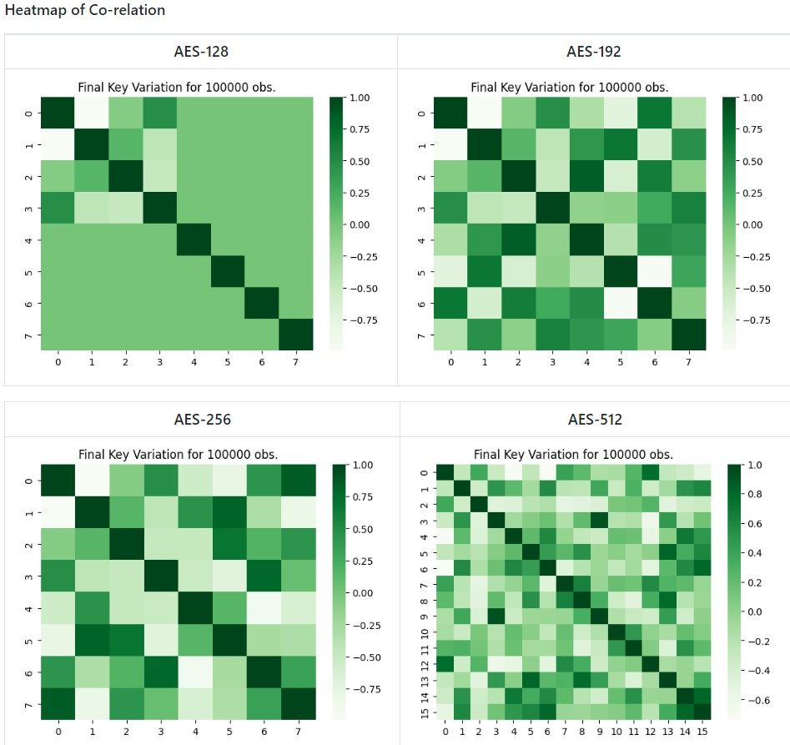
Variation in Key Scheduling
Pearson product-moment correlation coefficients of single and double dimensional array.
The analysis of secret key and last round keys for 1,00,000 (1 lakh) observation, where the symbol 'ρ' represents the new state generate is strong when the correlation is in range 0.25 to -0.25

Slide 35
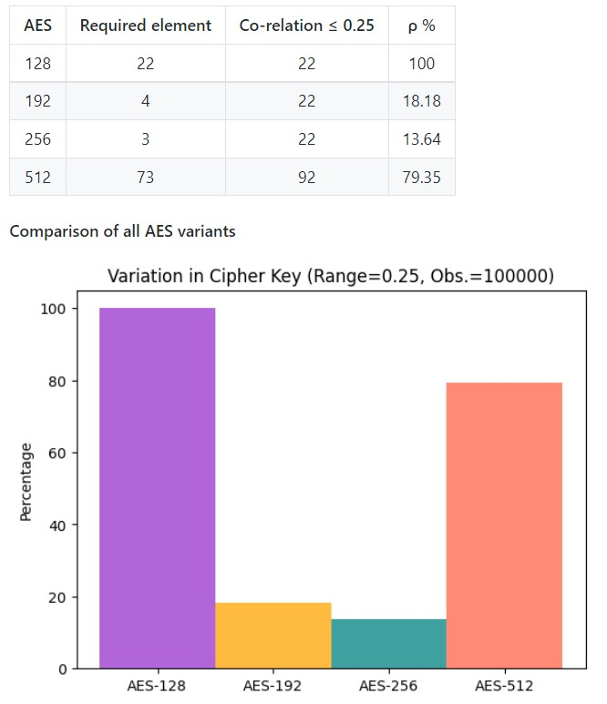
Observation
AES-128 Key Schedule have less correlation hence it is produces more variation
AES-256 and AES-192 is mainly have high correlation or high negatively correlation
AES-512 have slightly more correlation as compared to AES-128
The order of key variations:
AES-128 > AES-512 > AES-192 ≈ AES-256

Slide 36
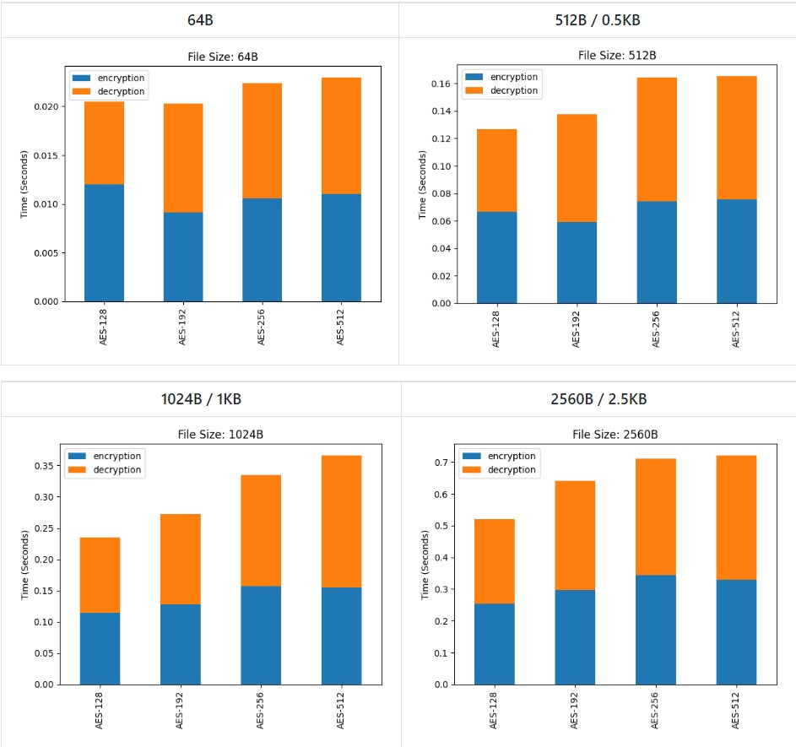
Encryption and Decryption Time
The analysis of the time taken by the AES algorithm to perform encryption and decryption for different file sizes are

Slide 38
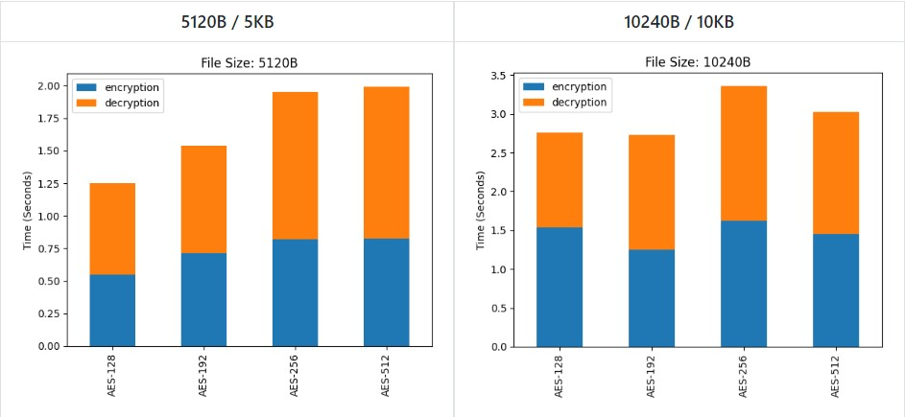
Observation
AES-512 takes nearly same time as compared to other AES variants mainly AES-256
However as the size of data increases the performance of AES-512 increases.

Slide 39
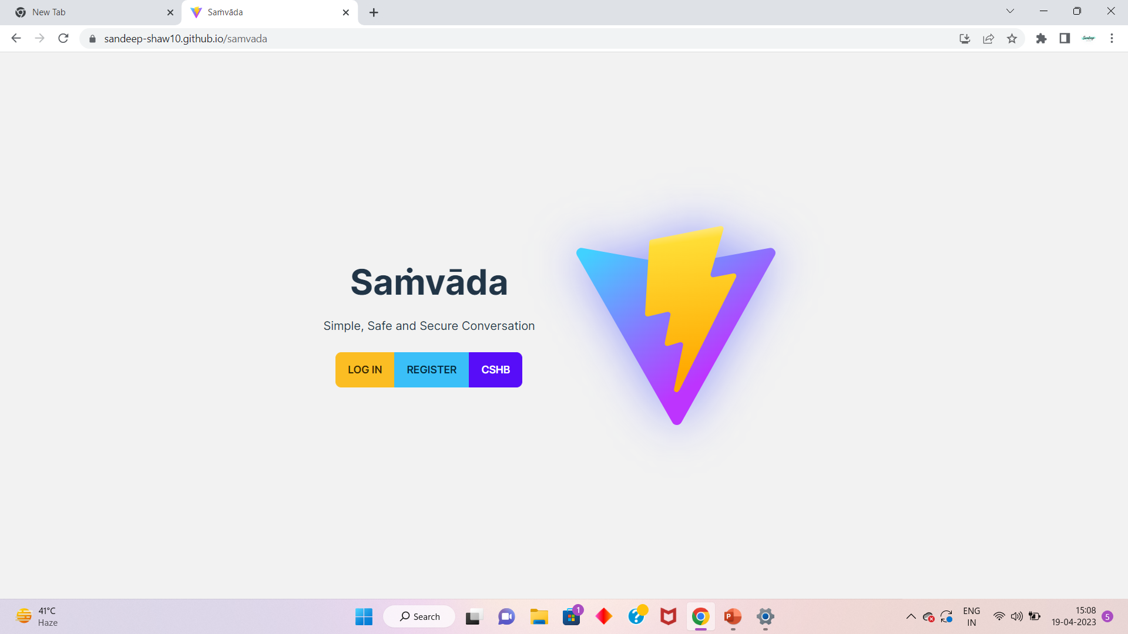
Saṁvāda App
Web Flow & Layout
Software Information
Application Preview
Database Storage
App Logo Source: https://vitejs.dev/

Slide 40


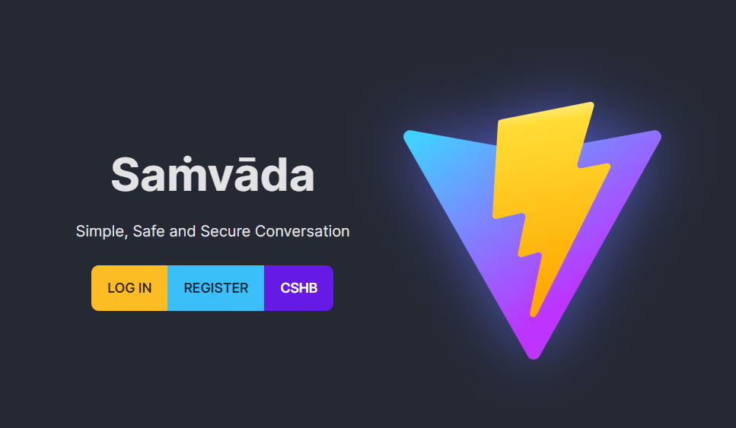
Live Demo
Weblink:
https://sandeep-shaw10.github.io/samvada/
App Logo Source: https://vitejs.dev/

Slide 41
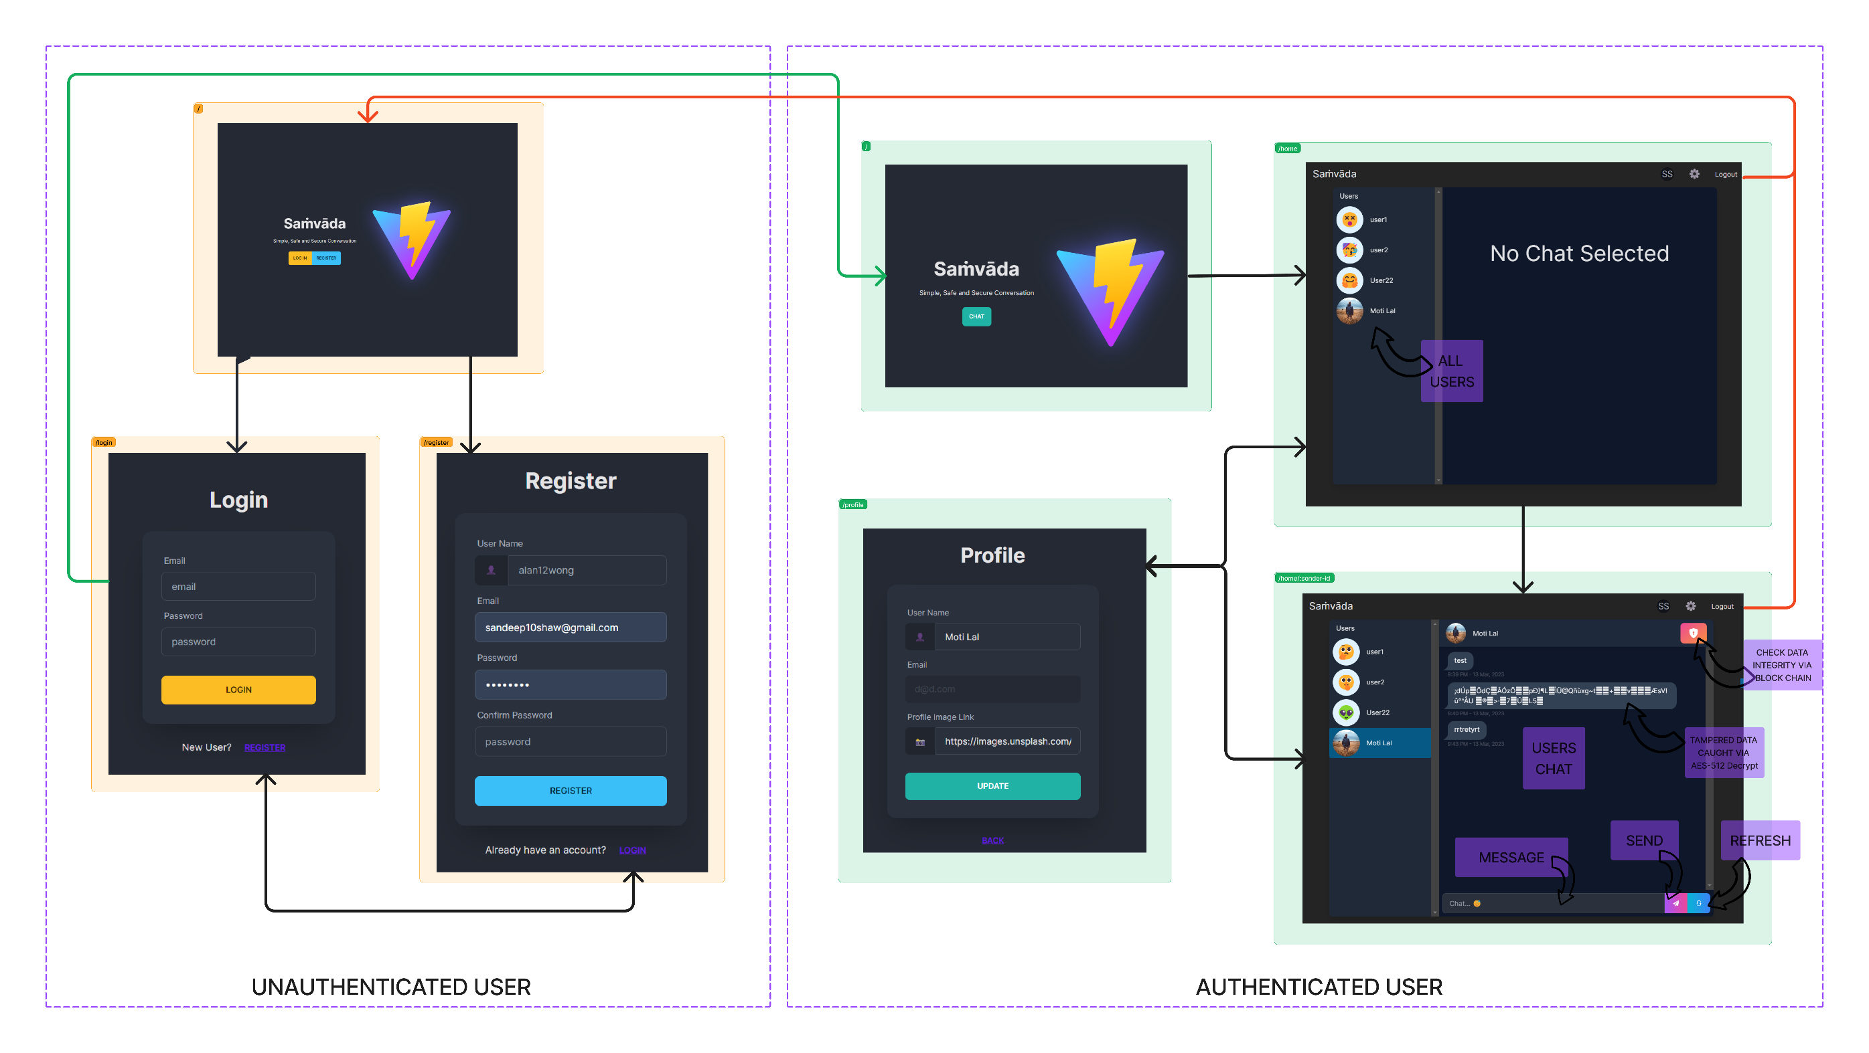
Web Flow & Layout

Slide 42
Software Information
Set up Authentication
Create Realtime Chat App
Implement AES-512 Encryption
Applying BlockChain
Detecting Data Tampering
Adding a Visualization for each Step
Software Development Life Cycle:
Iterative Incremental Model
Current Software Testing Stage:
Beta Testing
Version Control & Management:
Github
Requirement
Analysis
Design
Coding
Analysis:
Python, Jupyter, Numpy, Pandas, Seaborn
Coding:
ViteJS, TypeScript, React, TailwindCSS
Database & Storage:
Firebase Storage & Realtime DB, Device LocalStorage
Deployment:
Github-Pages

Slide 43
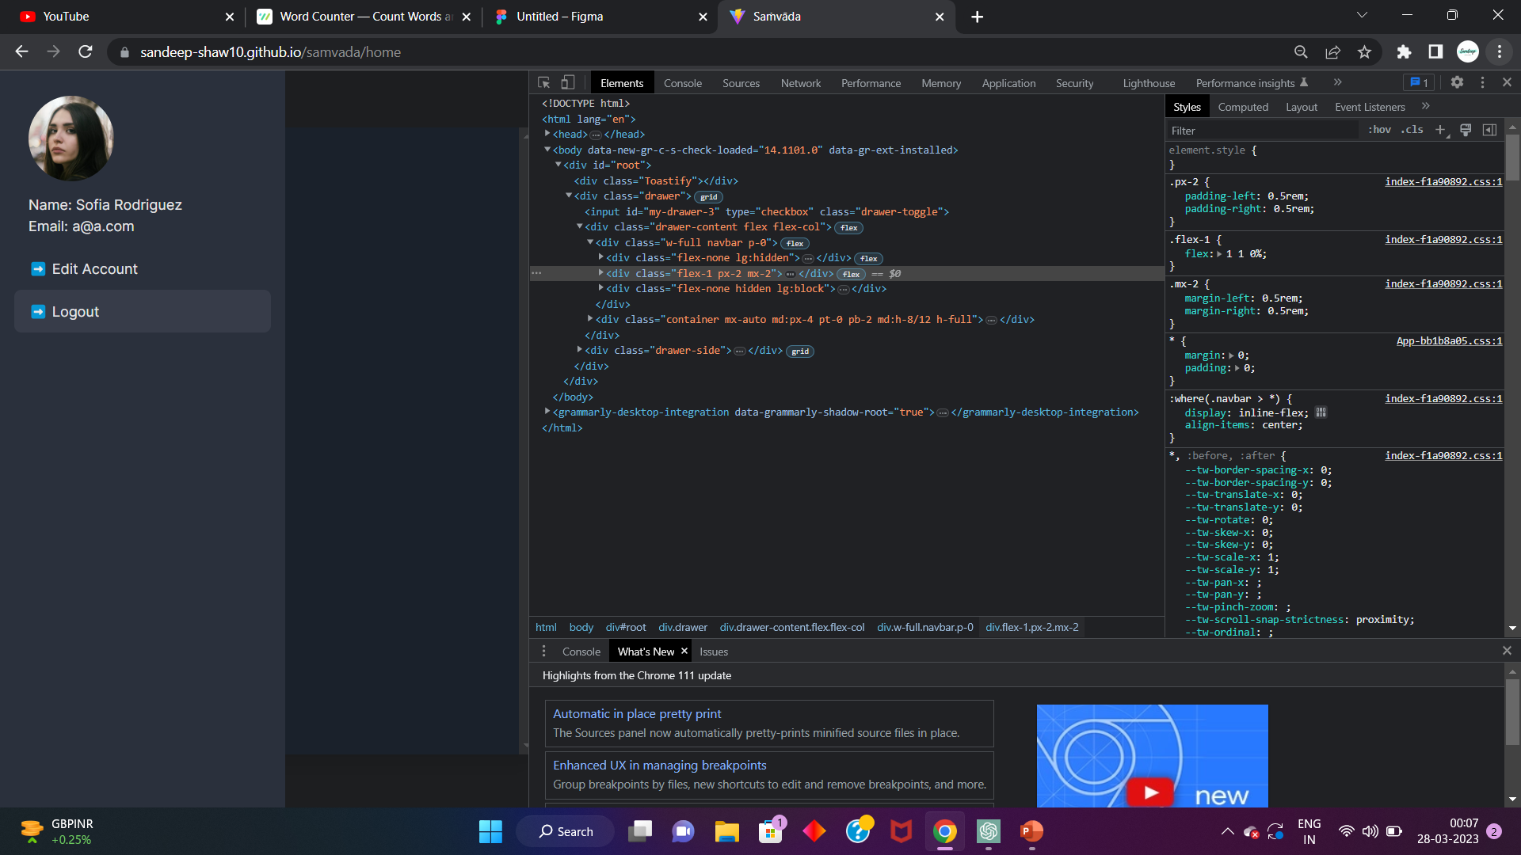
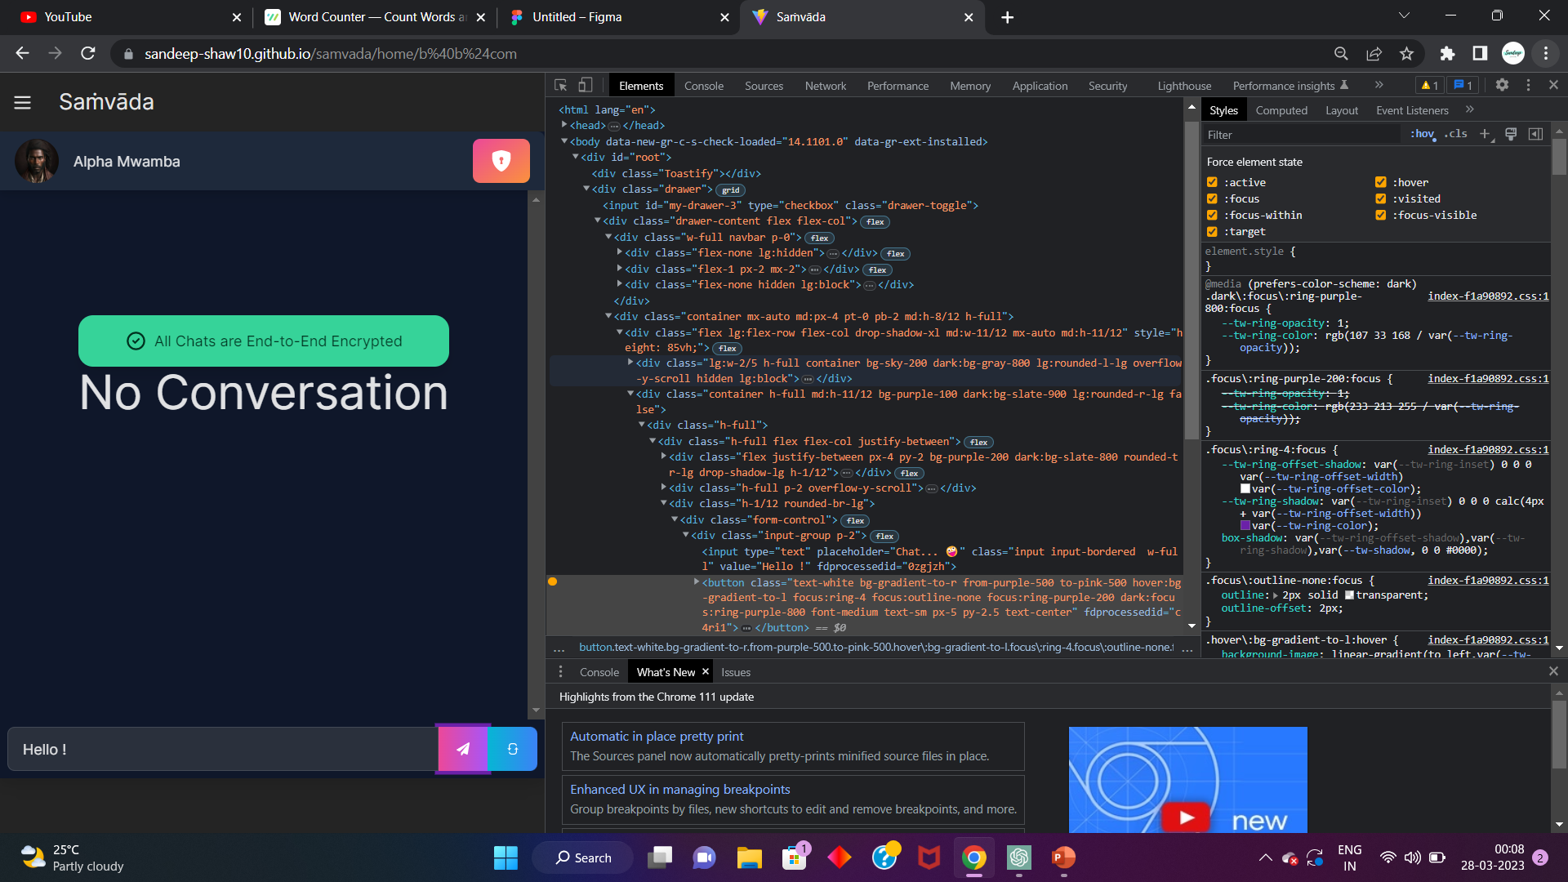
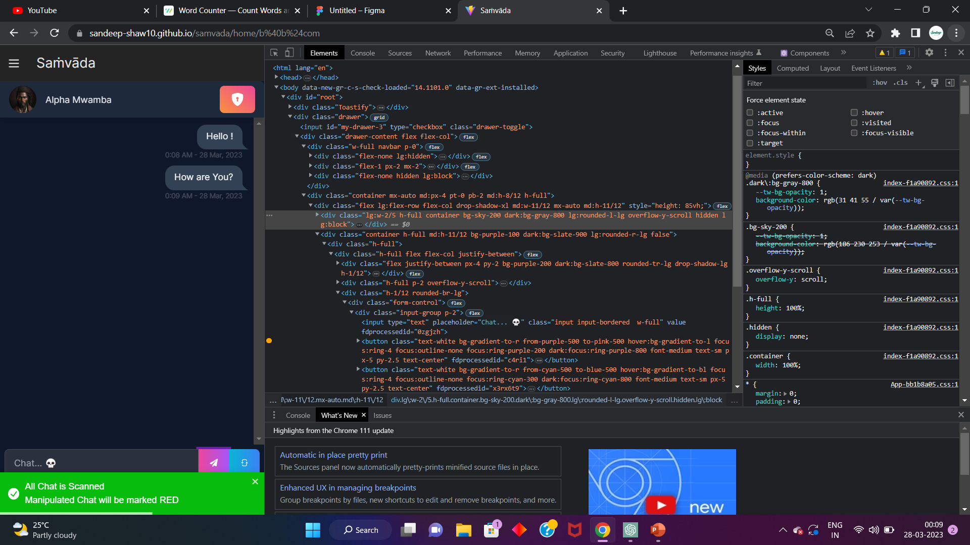
Application Preview
Mobile View

Slide 44
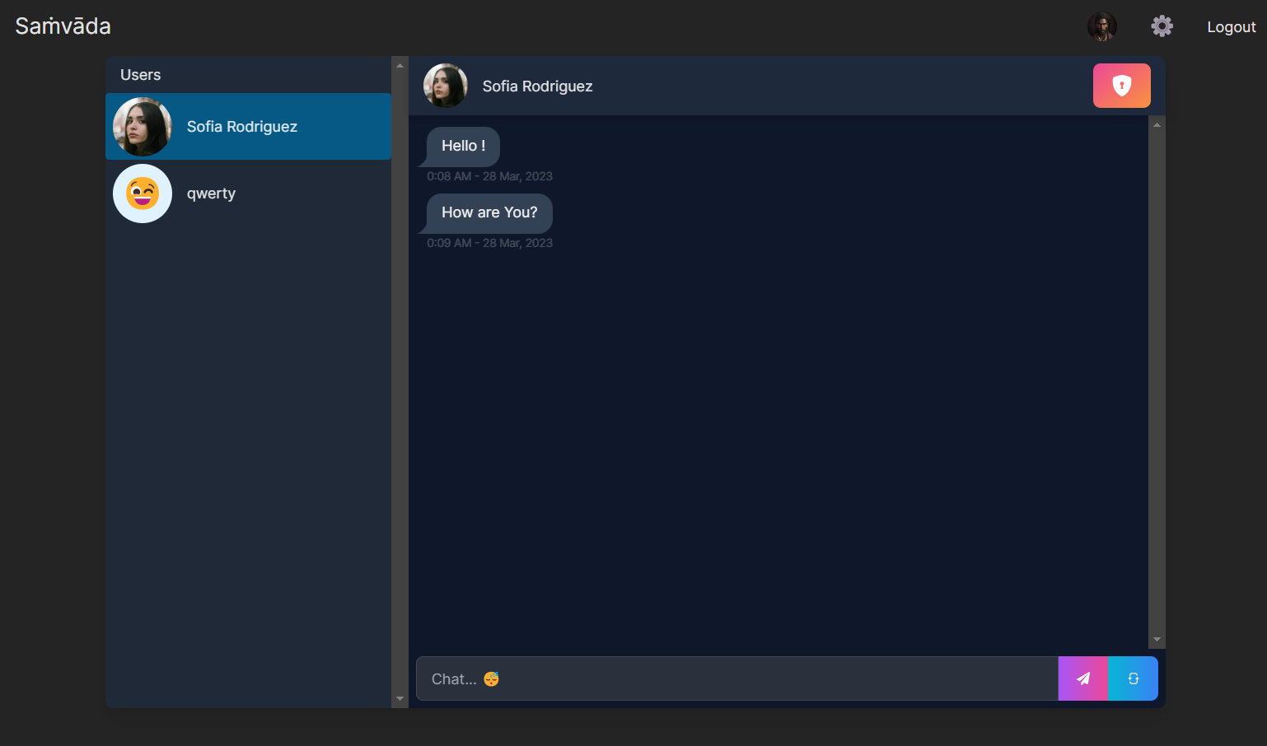
Desktop View

Slide 45
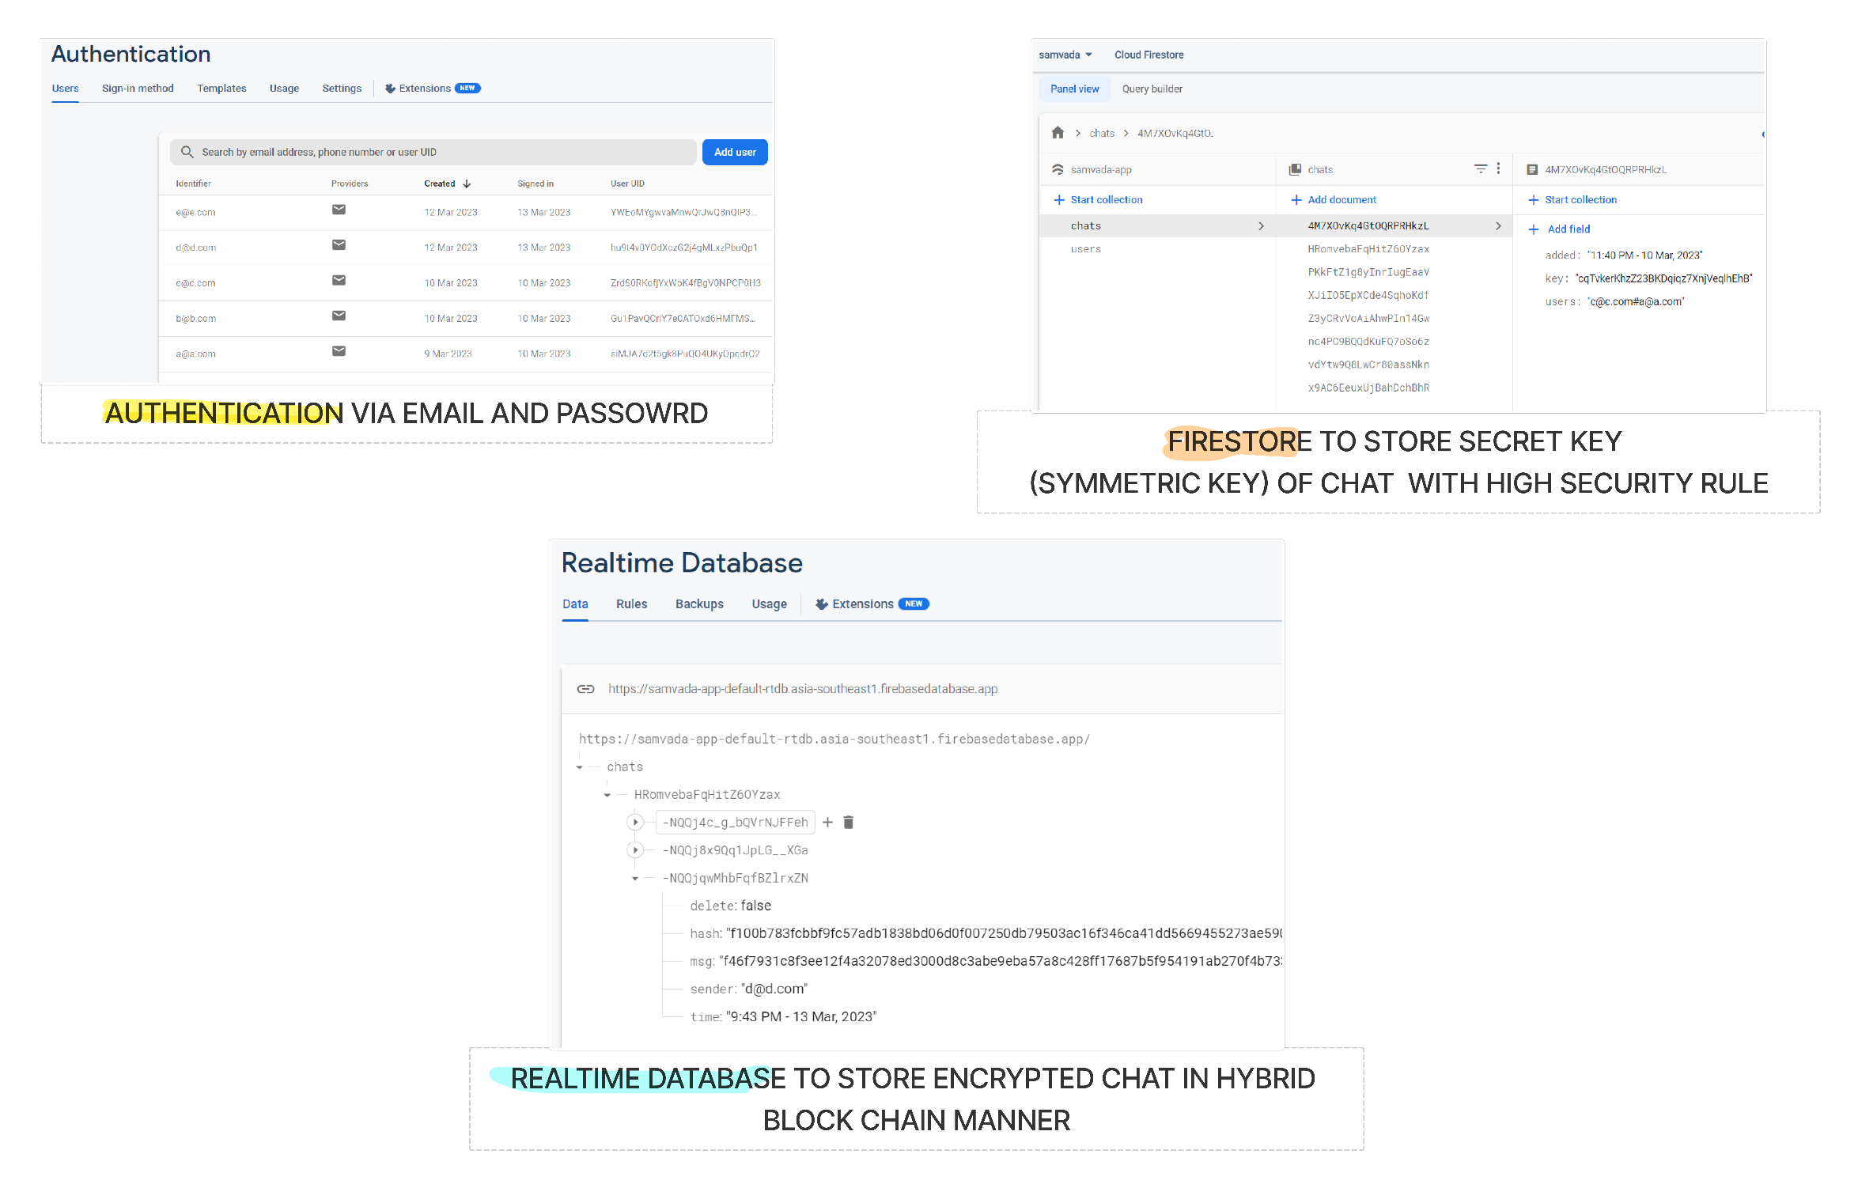
Database Storage
FIREBASE Auth

Slide 46
Firebase Storage

Slide 47
FIREBASE Realtime DB

Slide 48
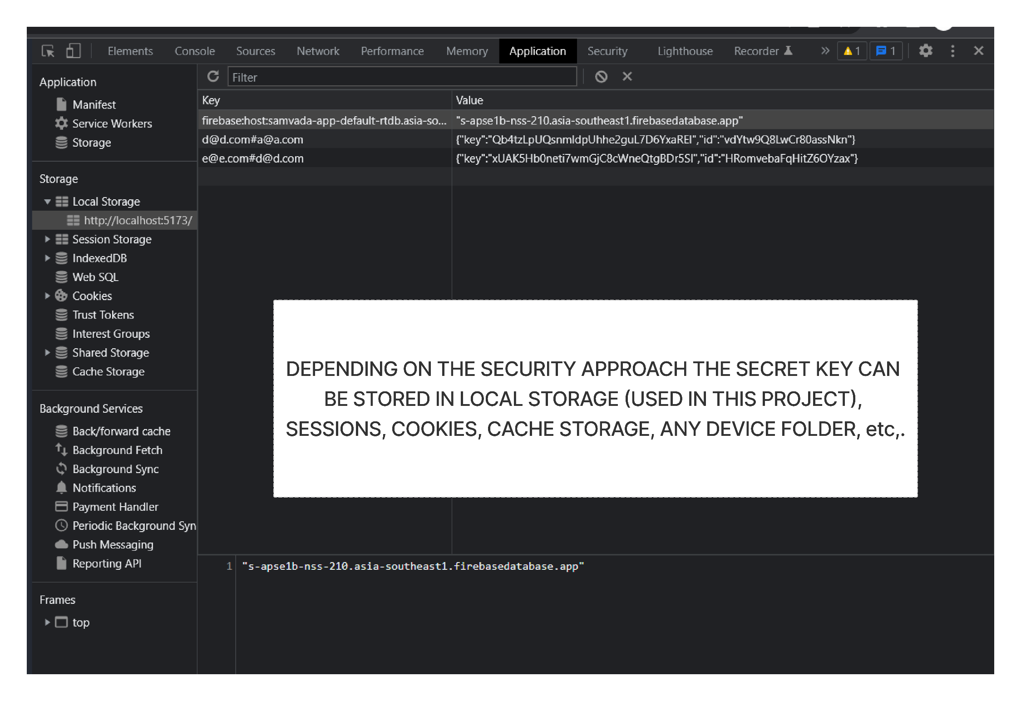
CHROME developmental tools: Localstorage

Slide 49
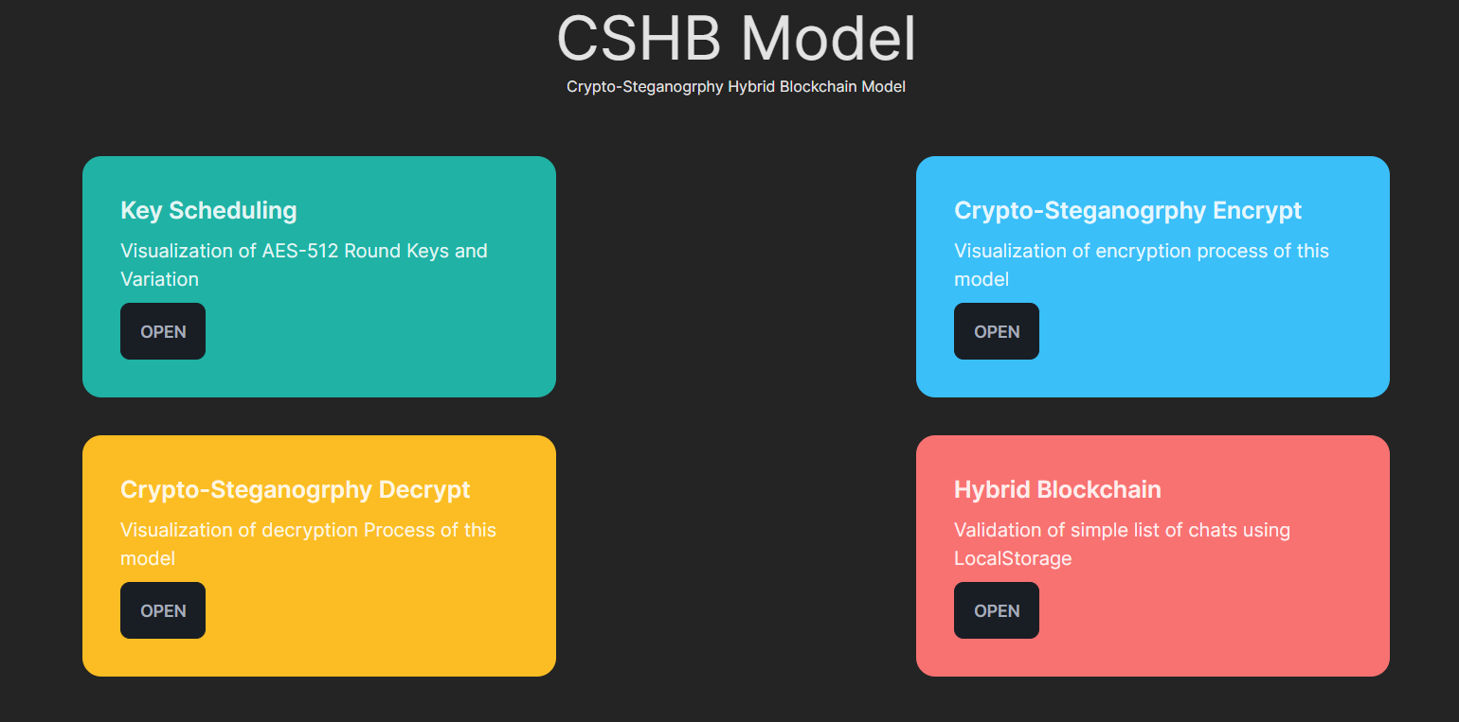
CSHB Visualization

Slide 50
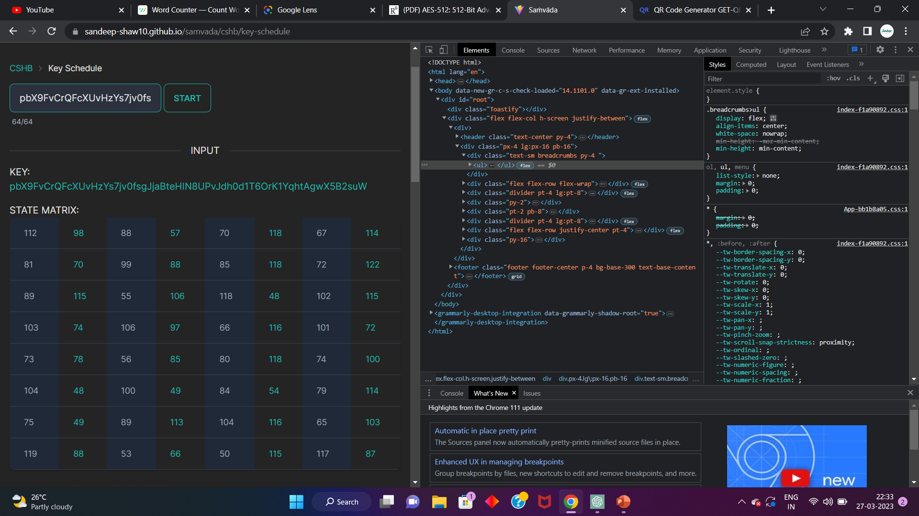
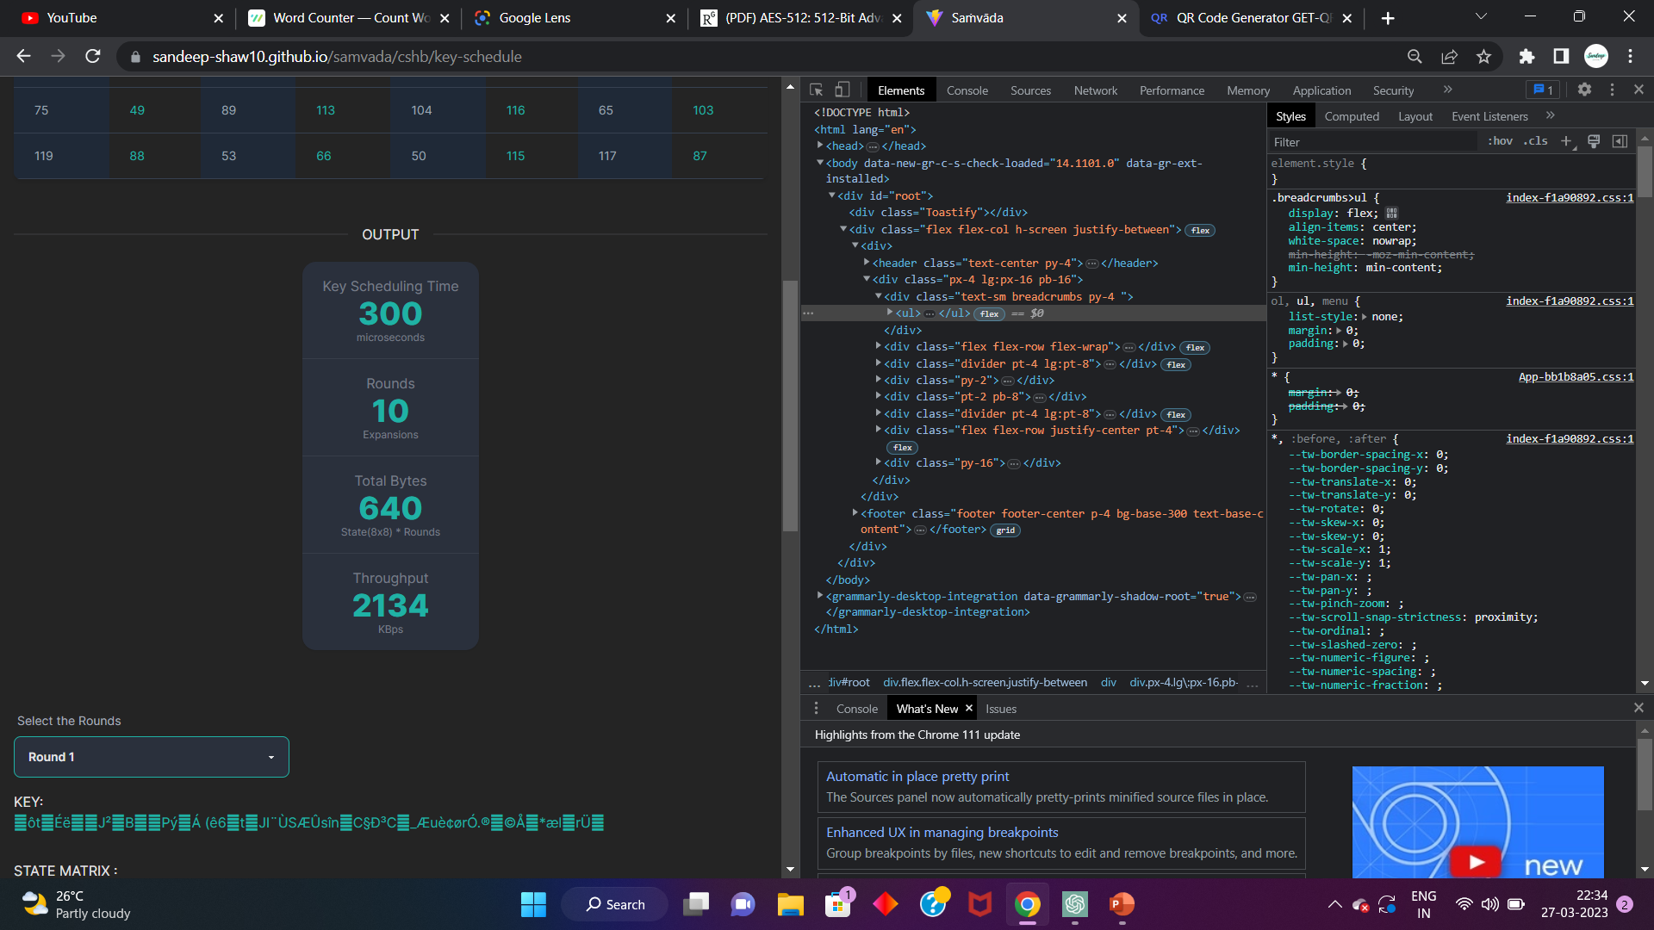
AES-512 Key Scheduling

Slide 51
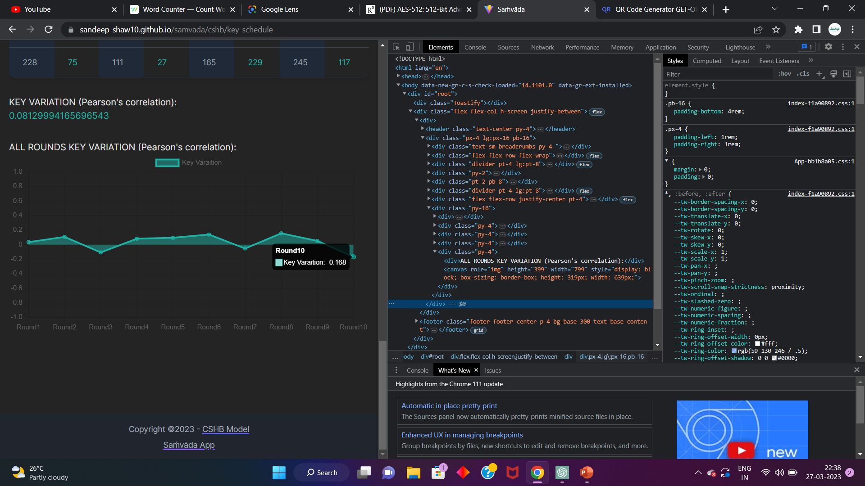
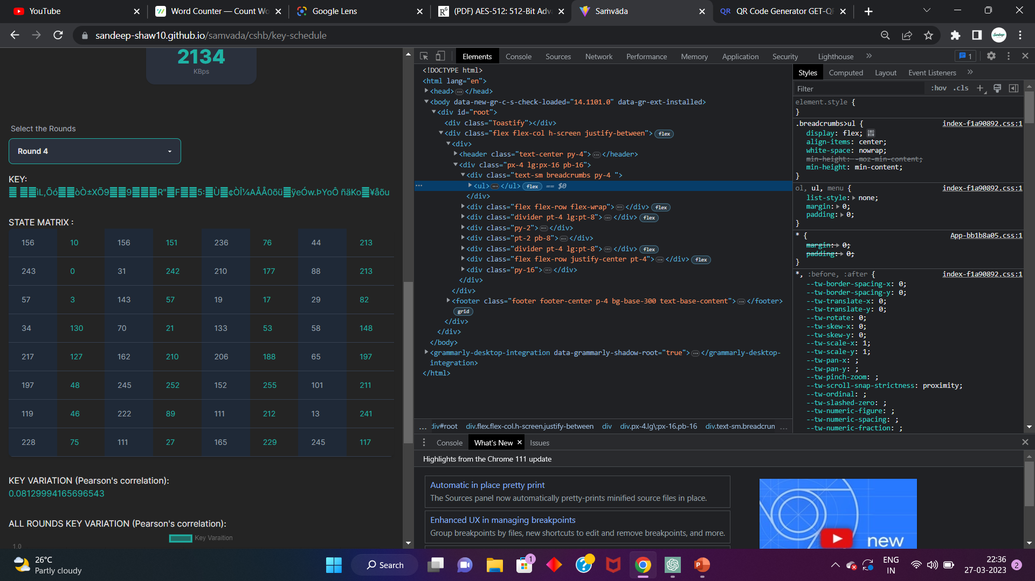

Slide 52
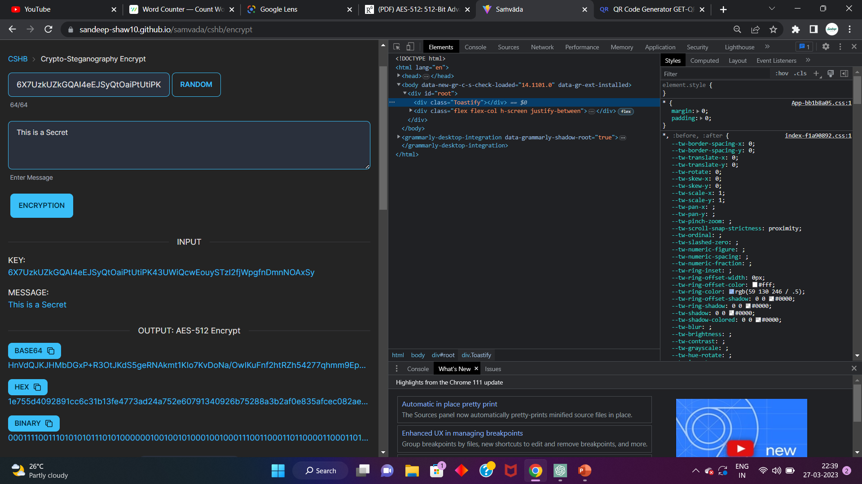
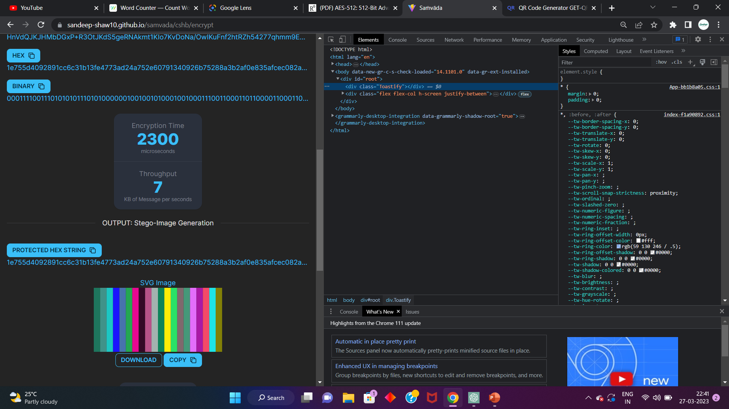
Crypto-Stego Object Encrypt

Slide 53
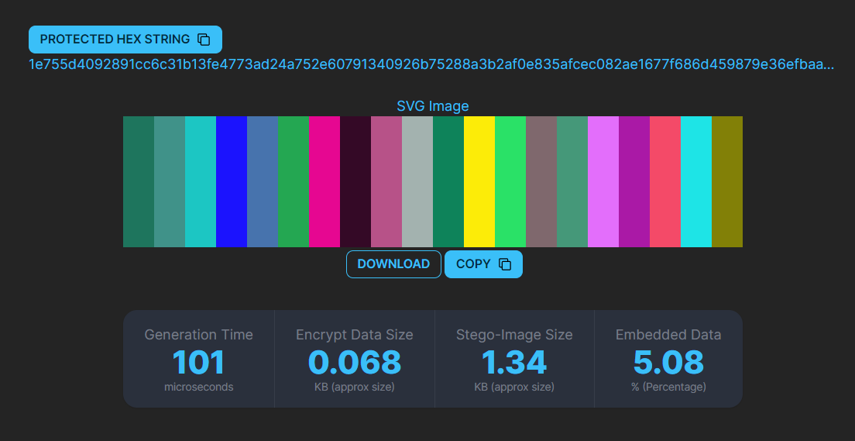

Slide 54
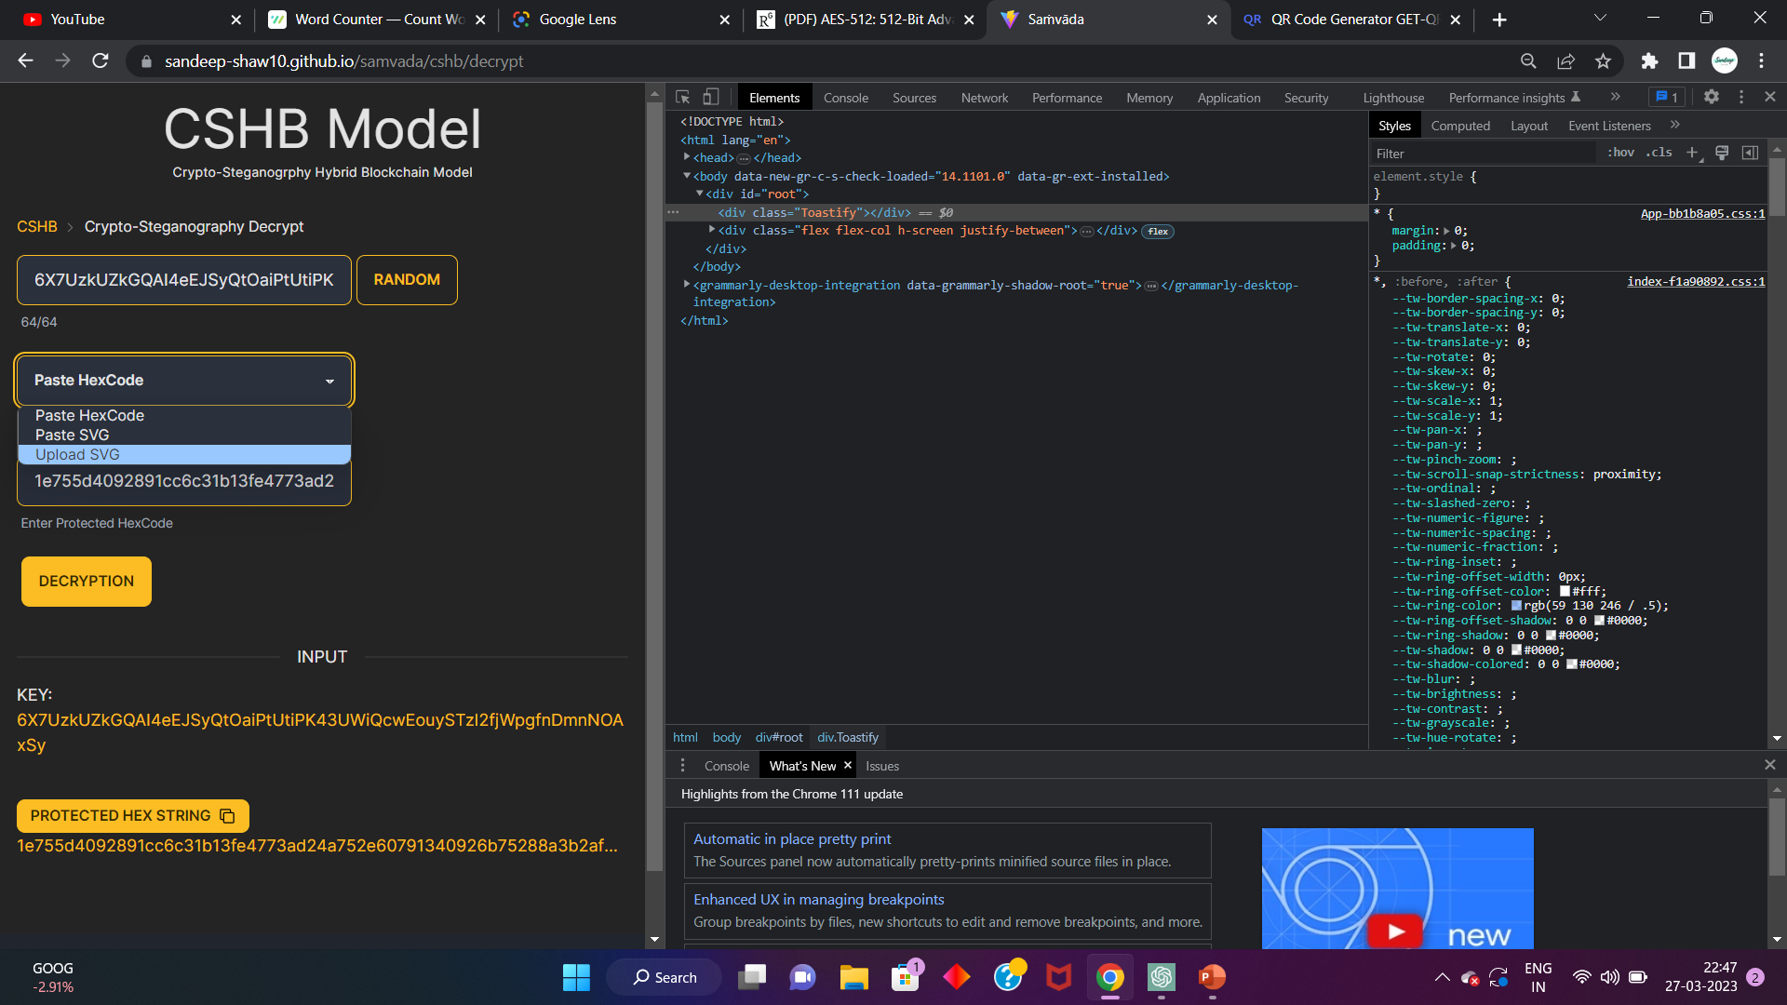
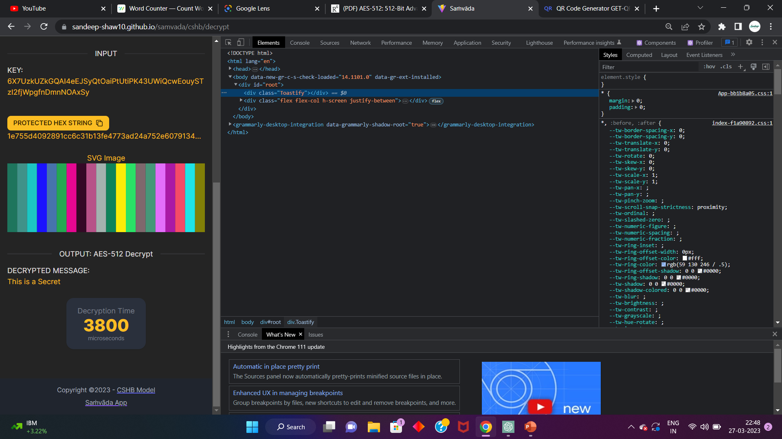
Crypto-Stego Object Decrypt

Slide 55
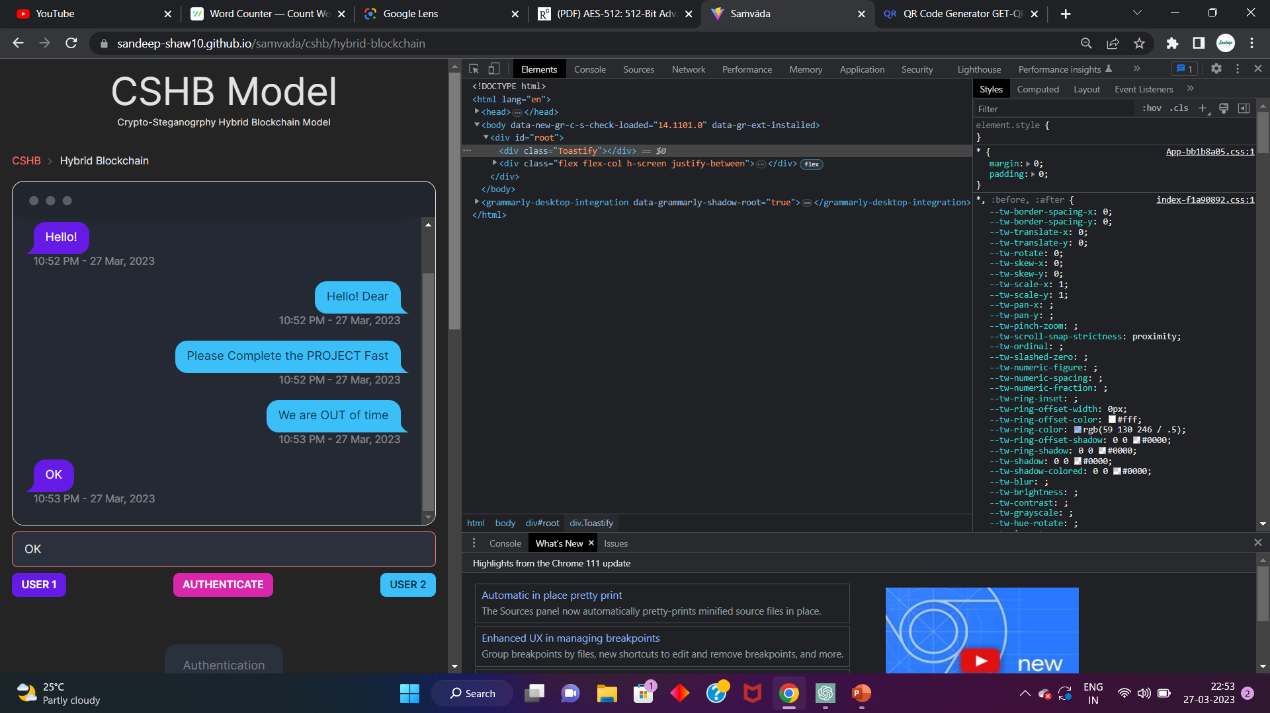
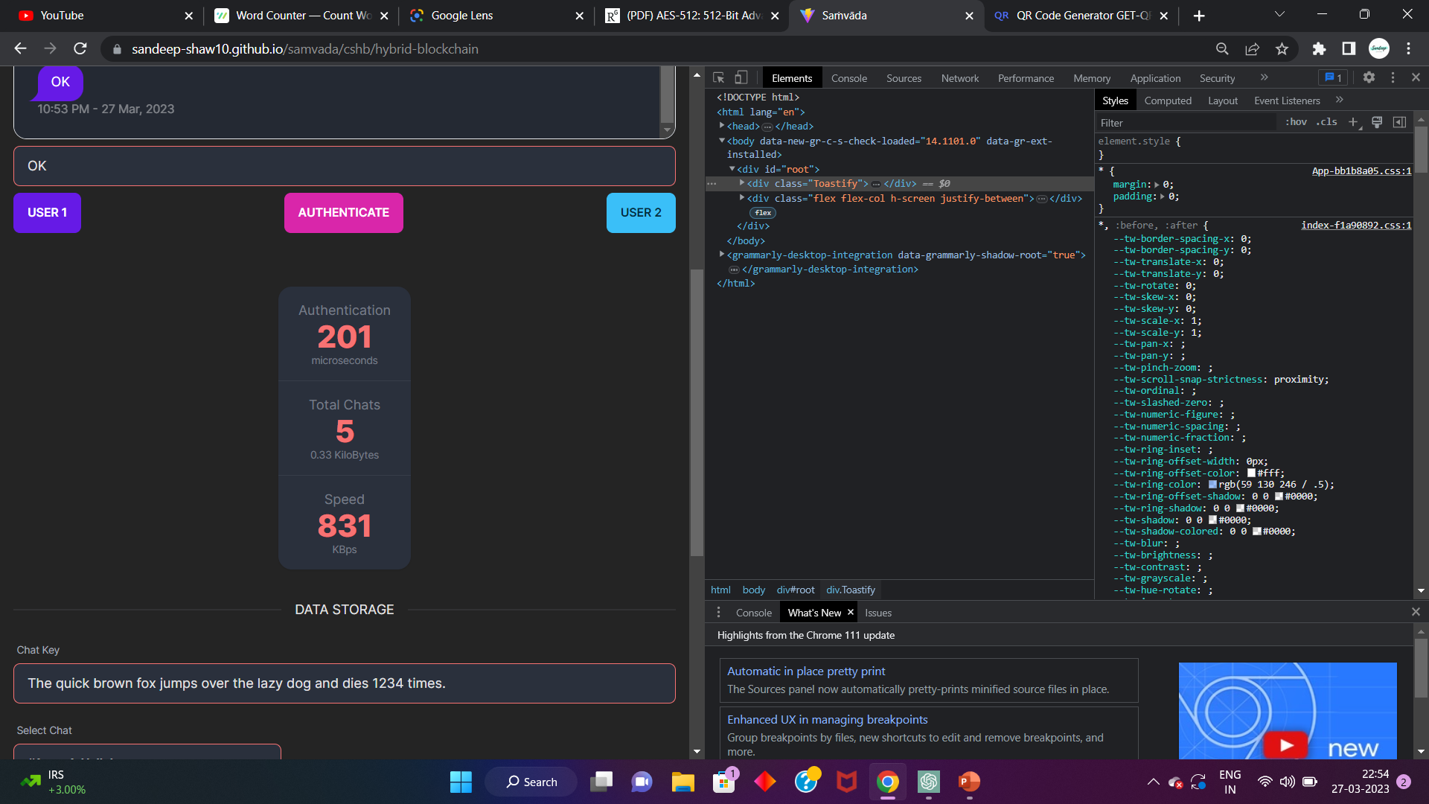
BlockChain Error Detection

Slide 56
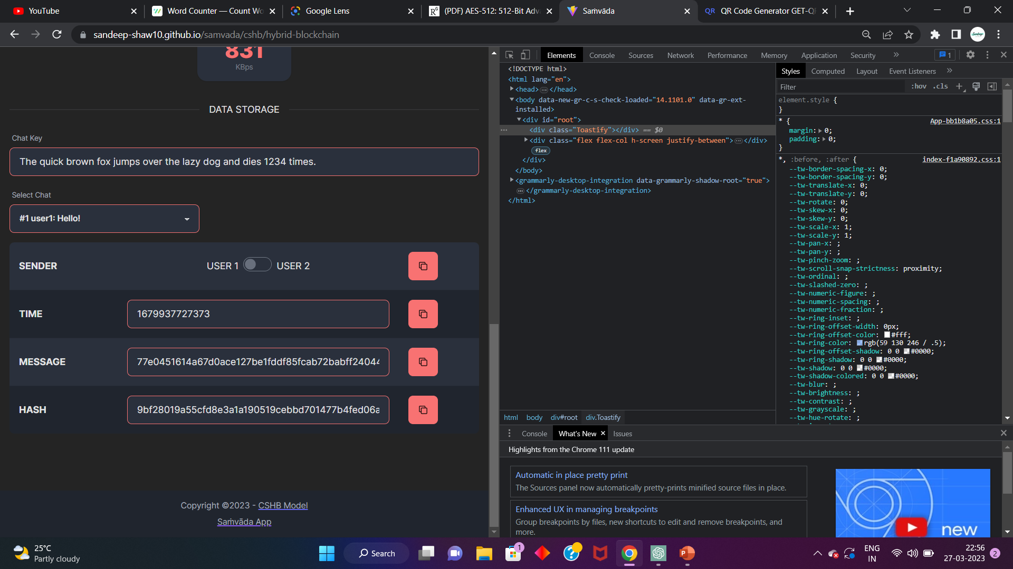


Slide 57

Reference
[1] Yeuan-Kuen Lee, Graeme Bell, Shih-Yu Huang, Ran-Zan Wang, and Shyong-Jian Shyu: “An Advanced Least-Significant-Bit Embedding Scheme for Steganographic Encoding”, 2009.
[2] “Applied Cryptography Protocols, Algorithms, and Source Code in C”, A book by Bruce Schneier.
[3] H. Gilbert and M. Minier, “A collision attack on seven rounds of Rijndael”, Proceedings of the 3rd AES Candidate Conference, (2000) April: 230-241.
[4] B. Schneier, “The GOST Encryption Algorithm”, Dr. Dobb’s Journal, v.20, n. 1, (1995) January: 123-124.
[5] "Data security using 512 bits symmetric key based cryptography in cloud computing system", Bijoy Kumar Mandal, Debnath Bhattacharyya and Xiao-Zhi Gao, (2019)
[6] “Efficient High-Performance FPGA-Redis Hybrid NoSQL Caching System for Blockchain Scalability”, Abdurrashid IbrahimSankaMehdi Hasan Chowdhury Ray C.C.Cheung, 2021.

Slide 58
Reference
[7] “The Design of Rijndael AES – The Advanced Encryption Standard”, a book by Joan Daemen, Vincent Rijmen, November 26, 2001.
[8] “AES 512: 512-bit Advanced Encryption Standard Algorithm Design and Evaluation”, Abidalrahman Moh’d and Yaser Jararweh Lo’ai Tawalbeh.
[9] “Ease of Side-Channel Attack on AES-192/256 by Targeting Extreme Keys”, Antonie Wurcker.
[10] “Side Channel Power Analysis of an AES-256 Bootloader”, Colin O’Flynn and Zhizing (David) Chen.
[11] "A Cost analysis of AES-128 and AES-512 on Apple mobile processors", Vatchara Saicheur and Krerk Piromsopa

Slide 59

Akash Kumar Sen
GCECTB-R19-3002
Arijit Mukherjee
GCECTB-R19-3007
Sandeep Shaw
GCECTB-R19-3022
Surajit Bera
GCECTB-R19-3036
THANK YOU

